Slide 1

Anticipatory Care Planning
Presentation to the Palliative and End of Life Care Cross Party Group
Tuesday 23rd February 2021
Tom McCarthy, Improvement Advisor, ihub
tom.mccarthy@nhs.scot
Improvement Hub
Enabling health and
social care improvement
Notes:
Alternative title and layout slides

Slide 2
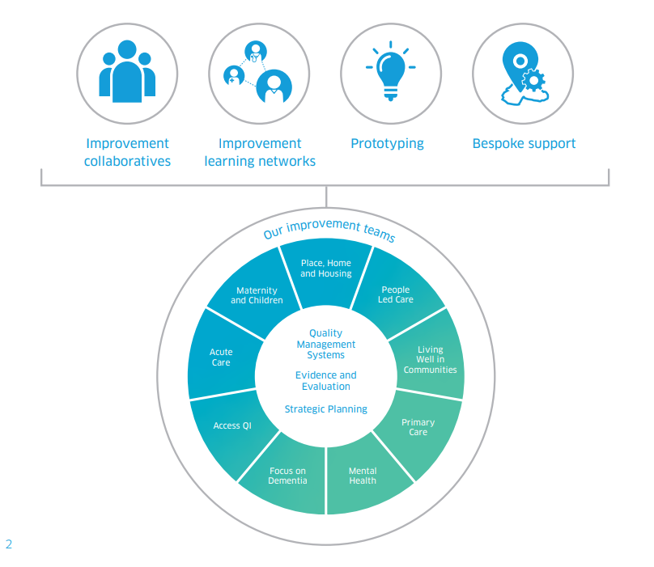
The ihub: who we are and what we do
Improvement Collaboratives
These are national improvement programmes working with multiple teams across Scotland to enable spread of existing good practice. They enable teams across multiple organisations to learn together about how to make improvements in a shared focus area. They have start and end dates, usually lasting for approximately 18 months.
Prototyping
Where there is a common problem across Scotland with no known solution, we will undertake prototyping work. During prototyping we usually work with up to three teams/sites to develop, test and refine ideas. Once we have a successful solution, we will develop guidance and tools to support its implementation in other areas.
Improvement learning networks These offer structured opportunities for individuals, teams, organisations and countries to share information and learning around specific topics or themes. Using a mixture of face to face learning sessions, site visits, online platforms and social media they support individuals and organisations to connect with others facing similar challenges.
Bespoke support
This offering aims to meet a specific improvement or transformation need within a local system. We work with the local system to co-design and co-deliver approaches right for that specific context.
Taken from: https://ihub.scot/media/6621/ihub-programme-directory-overview.pdf

Slide 3







ACP in the context of Covid-19
We are supporting health and social care services by focussing on:
Web Content
Supporting Covid-19 Resilience
ACP Webinar
Bespoke Support
Redesigning our website to make it easier to find information
Providing information on a range of tools
Sharing case studies of work across Scotland
Updated (November 2020) Essential ACP Tool and guidance
Working with NES Digital Service to develop digital tools
Developing guidance on reviewing the 1.2m Key Information Summaries
Session in March 2021 focussed on ACP.
Bringing together a wide range of experts from across Scotland
Sharing learning around ACP and what works at the current time
Available on request.
Key Links
ihub ACP Pages: ihub.scot/acp
HIS Covid Response on ACP: ihub.scot/essentialacp
Guidance on ACP and people with dementia
Communication skills to support ACP Effective Communication for Healthcare (EC4H)
NHS Inform Making a plan for your care during the COVID-19 pandemic

Slide 4




2021 and beyond: the ACP Learning System
The ACP Learning System will continue being a key element of our work and underpins all our activities. It aims to accelerate sharing of learning and improvement work through a range of engagement and learning opportunities.
Hosting webinars
Producing
evidence
summaries
Producing
case
studies
Supporting
networks
Responsive support via
the Primary Care
Quality Improvement
Faculty
Addressing inequalities
through capturing data
and sharing learning
Developing our website: ihub.scot/acp the one stop shop for all these resources

