Slide 1

The value of international volunteering
Stuart J Fergusson
BSc (Med Sci), MBChB, ChM, MRCS, DRCOG, PGCAP, FHEA
@sj_fergusson

Slide 2
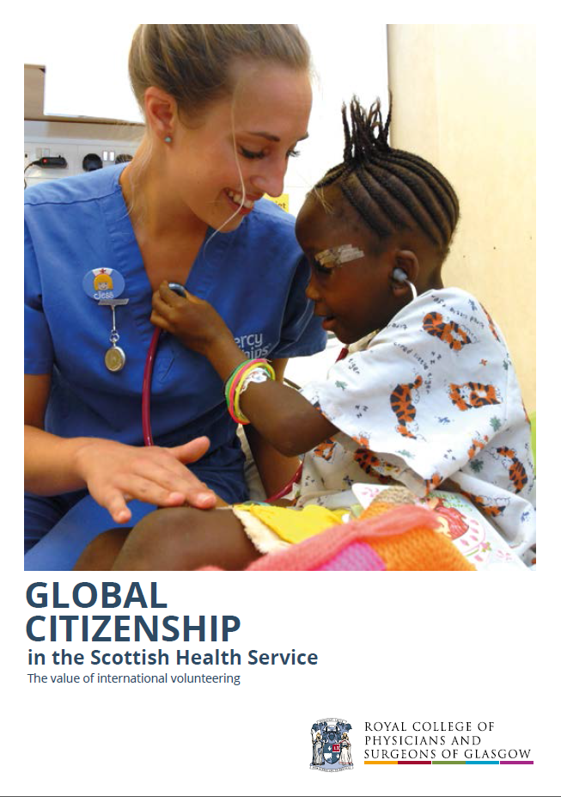
rcp.sg/globalcitizenship

Slide 3

www.scottishglobalhealth.org

Slide 4
Outline
What is the nature of international healthcare volunteering?
Why is a global perspective on health important…
  Internationally?
  Institutionally?
  Individually?
What are the challenges to international volunteering?
What are the current Scottish commitments to global health?

Slide 5

Volunteering
“It is a choice undertaken of one’s own free will, and is not motivated primarily for financial gain or for a wage or salary.”
Scottish Executive. Volunteering Strategy. 2004.

Slide 6
Professional Volunteering - approaches
coordinated – uncoordinated
short-term – long-term
grant funded – self funded
capacity-building – gap filling
‘lunch-break’ volunteering – in-country volunteering
All-Party Parliamentary Group on Global Health. Improving Health at Home and Abroad: how overseas volunteering from the NHS benefits the UK and the world. 2013.

Slide 7
International experience in the NHS?
Cross-sectional survey: 911 NHS staff in NW England
“Have you had any periods in another country, either as an employee or volunteer?”
Chatwin J, Ackers L. Volunteering and overseas placements in the NHS: a survey of current activity. BMJ Open. 2016.

Slide 8
survey results
Countries | # Respondents
Malawi | 45
India | 19
Uganda, Zambia | 18
Kenya, Sierra Leone | 17
Tanzania | 16
Nepal | 11
Rwanda | 10
Ghana, Nigeria, Zimbabwe, Ethiopia | 9
European countries, South Africa | 7
Sudan, Mozambique | 6
Bangladesh | 5
Others… | 4 or less
SGHC volunteering survey:
414 respondents
130 involved in global health work
Many countries visited…

Slide 9

Health Partnership Scheme
£30m from 2011-17
Remit to invest in institutional health links
Managed by THET on behalf of DFID
“HPS projects have improved the knowledge, skills and confidence of health workers and in many cases this has contributed to increased quality of care or new services.”
    Taylor G, May K, McMeekin P. Health Partnership Scheme: Evaluation Synthesis Report. DFID. 2016.

Slide 10
Why is a global perspective on health important… internationally?
International inequities
Shared threats and challenges
Opportunity to project values globally

Slide 11
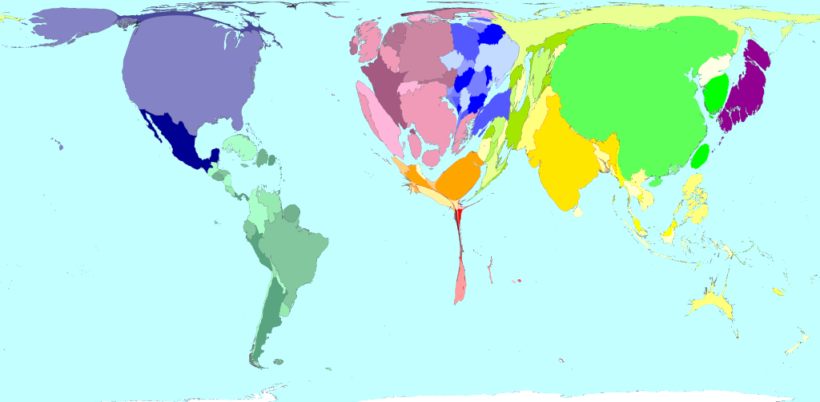
Physician density 2004 – www.worldmapper.org archives

Slide 12


Slide 13
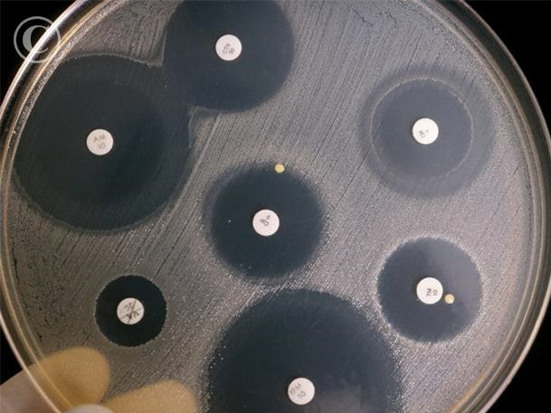

Slide 14

“International development is a key part of Scotland’s
global contribution within the international community. It encompasses our core values, historical and contemporary, of fairness and equality. It is about Scotland acting as a good global citizen.”

Slide 15
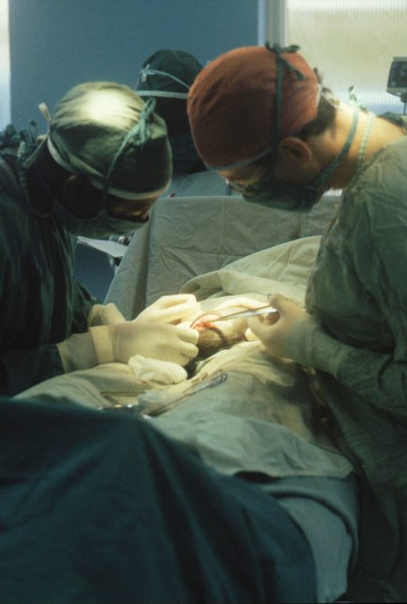
Why is a global perspective on health important… institutionally?
Recruitment and retention
System learning and capacity building
Professional development of the workforce
Improved Scottish patient experience
Reputational development

Slide 16
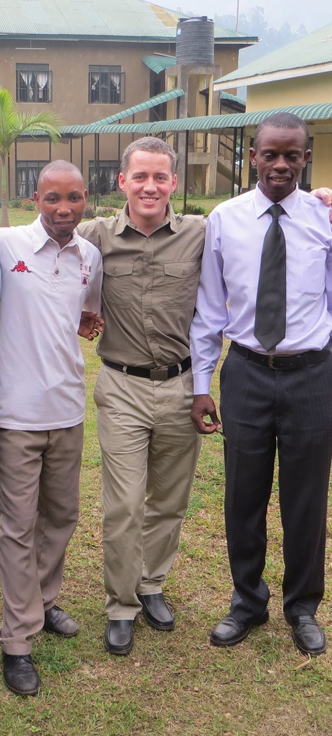
Why is a global perspective on health important… individually?
Leadership and management skills
Communication and teamwork
Clinical skills
Policy awareness and experience
Academic skills
Patient experience and dignity
Personal resilience, satisfaction and interest

Slide 17

Challenges of global health engagement
Service delivery
Financial costs
Personal health and security
Opportunity costs
Regulatory difficulties
Reputational risk

Slide 18
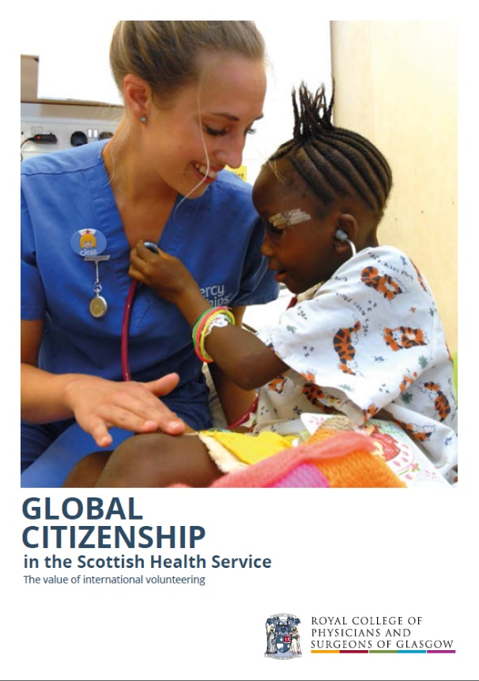
Recommendations
Developing a strategic approach
Professionalising/resourcing coordination and support
Maximising benefit
Ensuring effectiveness
Valuing collaboration
Expressing local commitment
Defining support mechanisms
Setting expectations

Slide 19
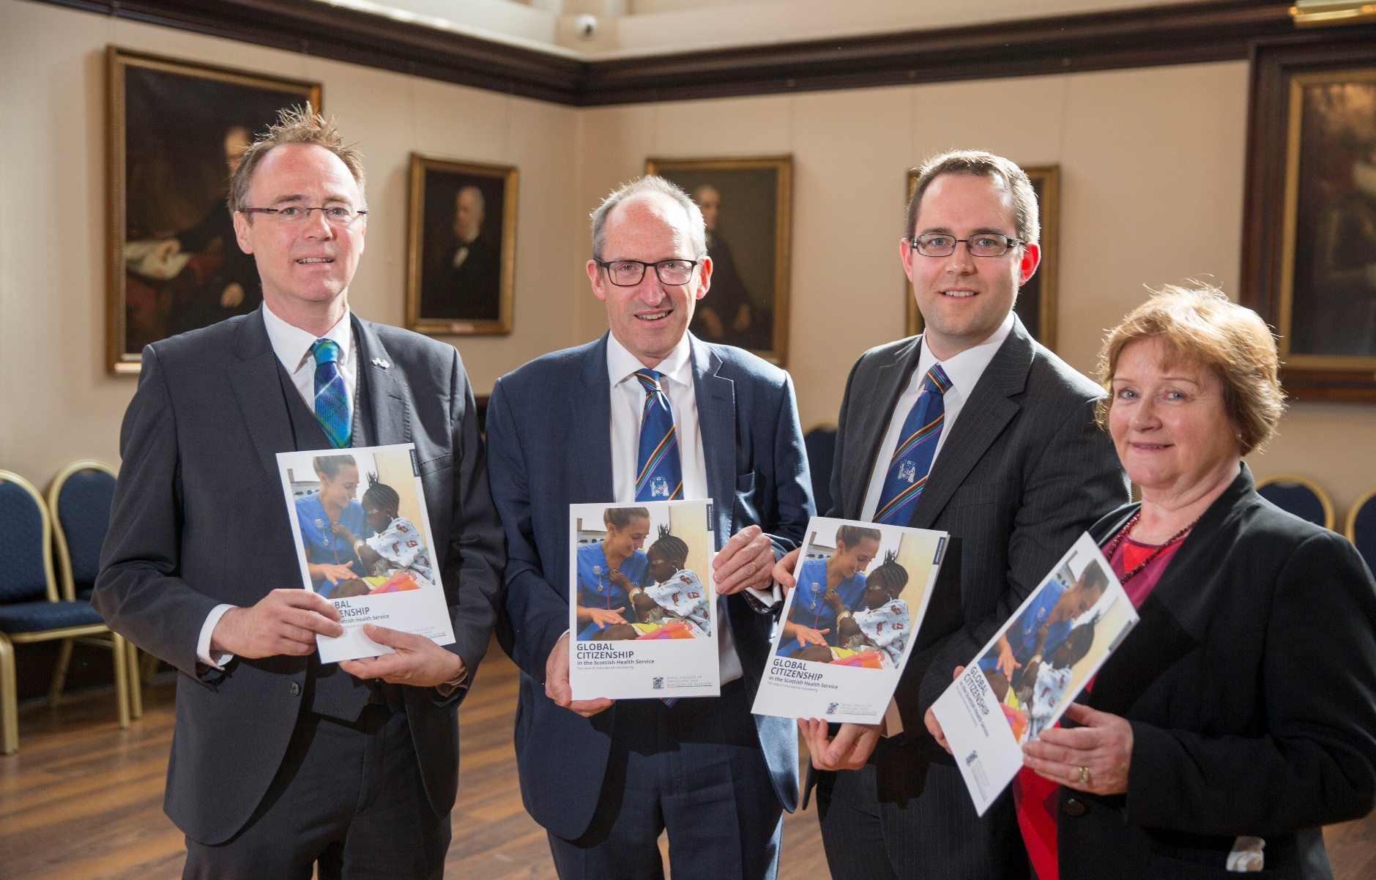
Report launch

Slide 20

Programme Board established
Programme Manager/Development Team appointed
Developing directory of health partnerships, funding sources and register of interest in global citizenship
Mapping International Medical Training Initiatives
Establishing network of ‘global citizenship champions’
Developing ‘Rural Health Global Citizenship Fellows’

Slide 21
