Slide 1

ACP in Scotland
Public engagement and information
Rebecca Patterson
Director of Good Life, Good Death, Good Grief

Slide 2


For people to be empowered to take an active role in ACP conversations…
…there needs to be public-facing information about ACP that:
People can find
People can understand
People can trust
Answers people’s questions about ACP
Photo: Volodymyr Hryshchenko

Slide 3

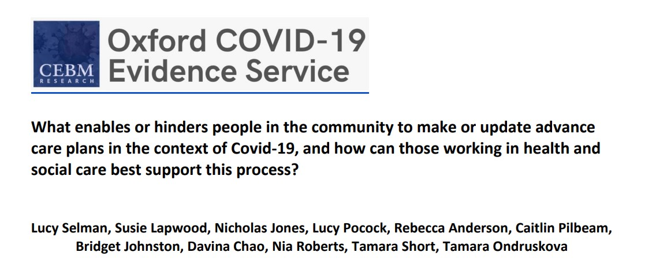
“existing guidelines and resources are to a major extent clinician-focused;
there are few video- and web-based ACP resources for the public and those that exist are scattered and piecemeal.
This is a concern given good quality evidence that online and video ACP interventions are beneficial, particularly among people with limited English proficiency, poor health literacy and/or from otherwise disadvantaged communities.”

Slide 4

Are the best resources collected together in one place?
Are the resources in the places where people will look for them?
What public engagement has been done to see if we’re really providing the information people want, in a way that they are able to access?
Is NHS Inform the best place to go for ACP information?
Can the official information be updated efficiently and to a high standard?

Slide 5

“In the context of COVID-19, and to reduce inequalities in access to ACP, we recommend national investment in evidence-based, public-facing resources and systems to support ACP.
Alongside this investment, simultaneous, interconnected strategies are needed to support ACP, underpinned by healthcare policy. This should include training for those working in health and social care, better coordination of electronic medical record systems, and public education and awareness raising.”

Slide 6
Suggestions include:
dispelling fears and misperceptions
public health messaging that reframes ACP as routine and normal
a public-facing web portal for ACP resources, using audio-visual as well as written formats, and designed to support disadvantaged communities.
Prioritising research into an integrated web-based system for ACP

Slide 7

Public engagement
Listening - what do people want and need?
Promoting the information that’s there.
Public Information
Ensuring that comprehensive, clear & honest information is available in the places people expect to find it.

