Slide 1
Partnering to achieve integrated palliative care; an essential component of #UHC
Dr Mhoira Leng FRCP
Palliative Care, Makerere University, Kampala
Cairdeas Palliative Care Trust, Scotland
Global Health Academy, University of Edinburgh
International Hospice and Palliative care Association

Slide 2
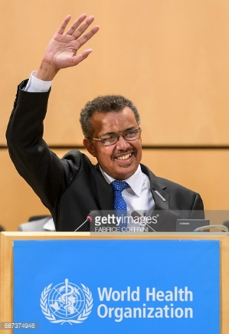
Global health priorities
Universal health Coverage
‘Leaving no-one behind’
‘Healing of the nations’
‘ I regard universal health coverage as WHO’s top priority. All roads lead to universal health coverage…..
These people are being denied a fundamental a human right.’

Slide 3
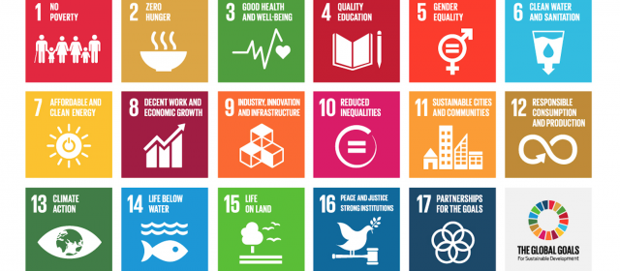
Global health priorities
Sustainable development goals
  17 SDGs and 169 targets to end extreme poverty, fight inequality and injustice, and protect our planet by 2030.

Slide 4
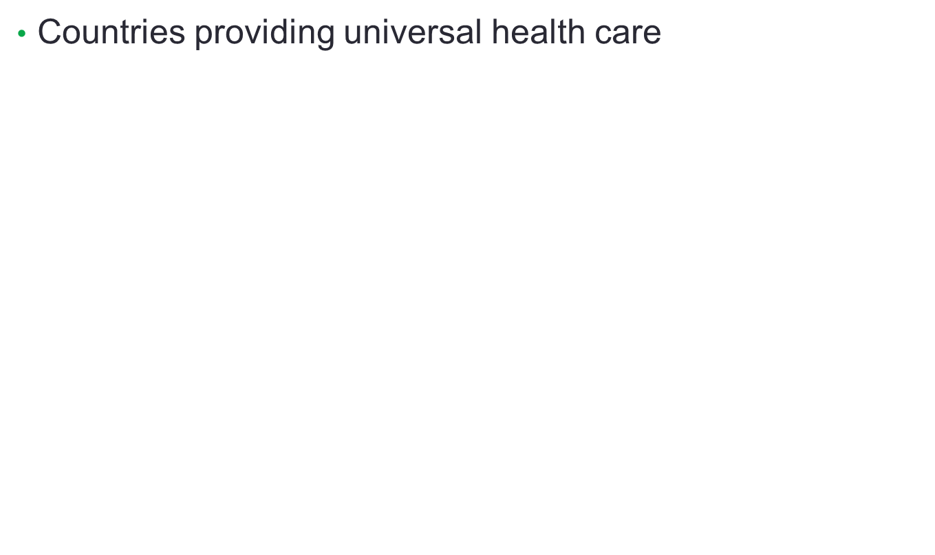
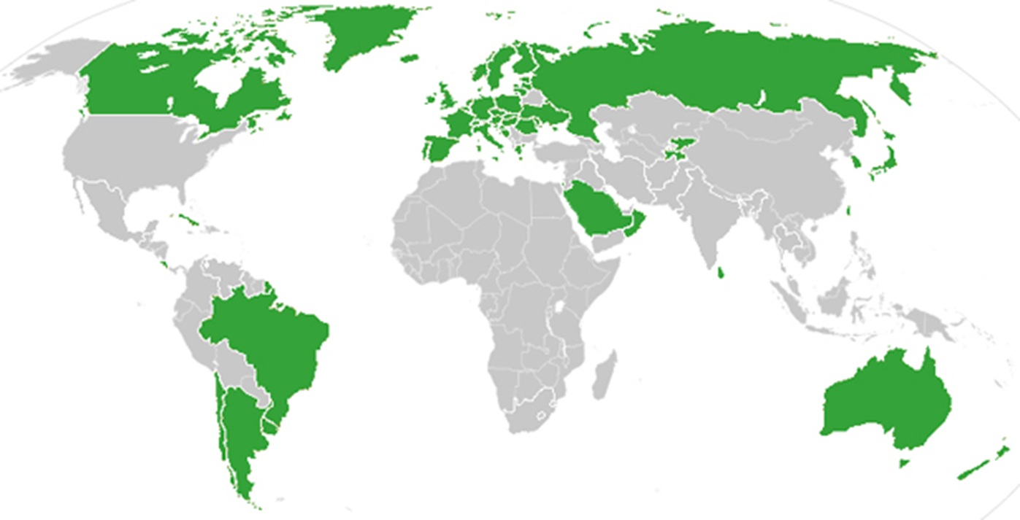
Global health priorities

Slide 5
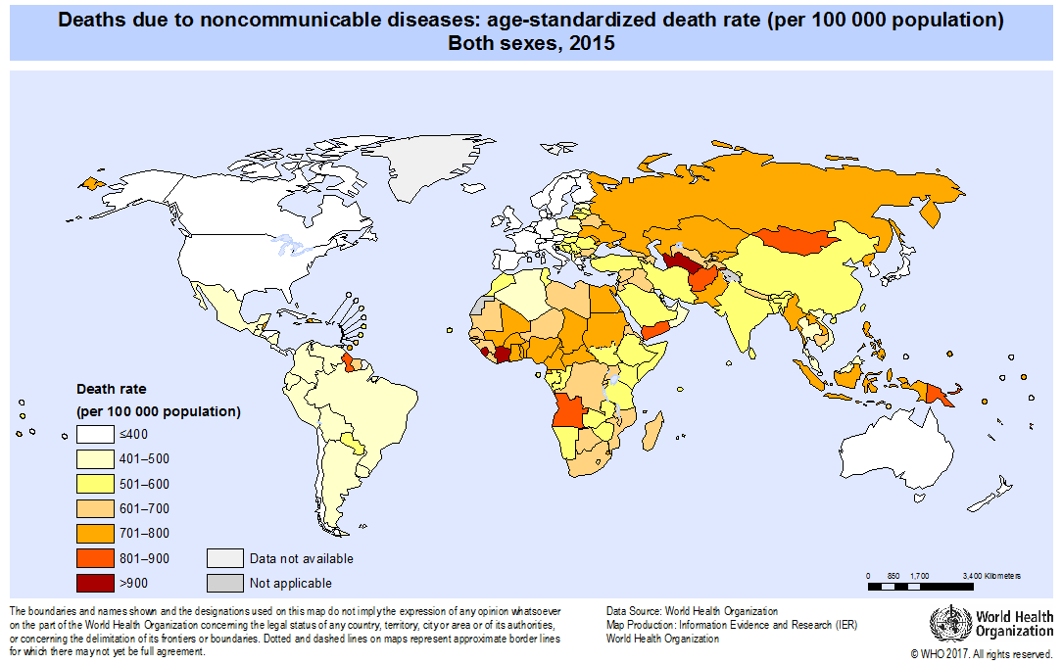
Global health priorities
NCD’s and multi-morbidity

Slide 6
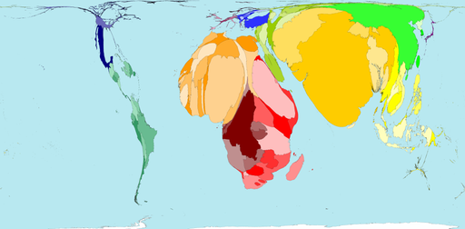
Global burden of disease

Slide 7
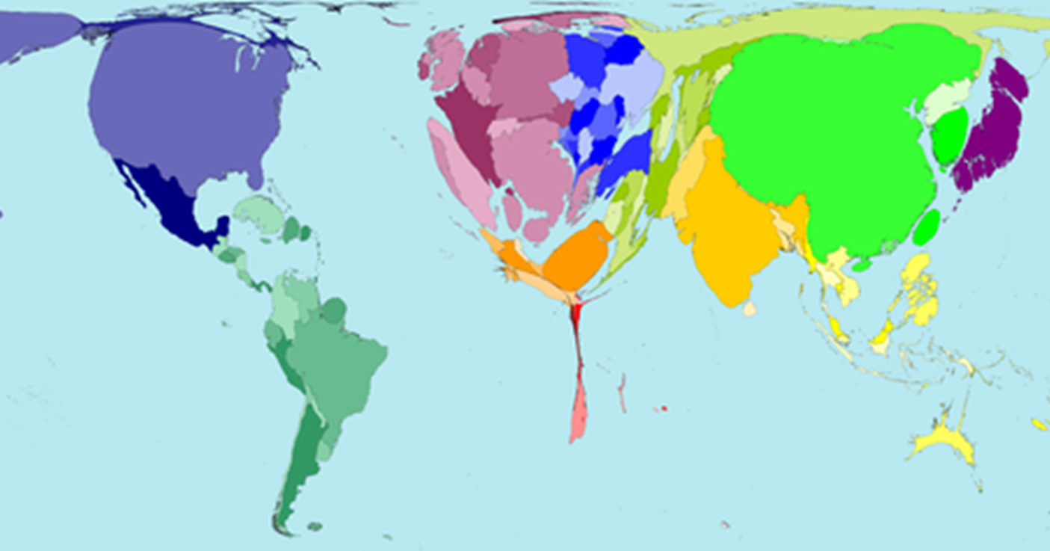
Physician access

Slide 8
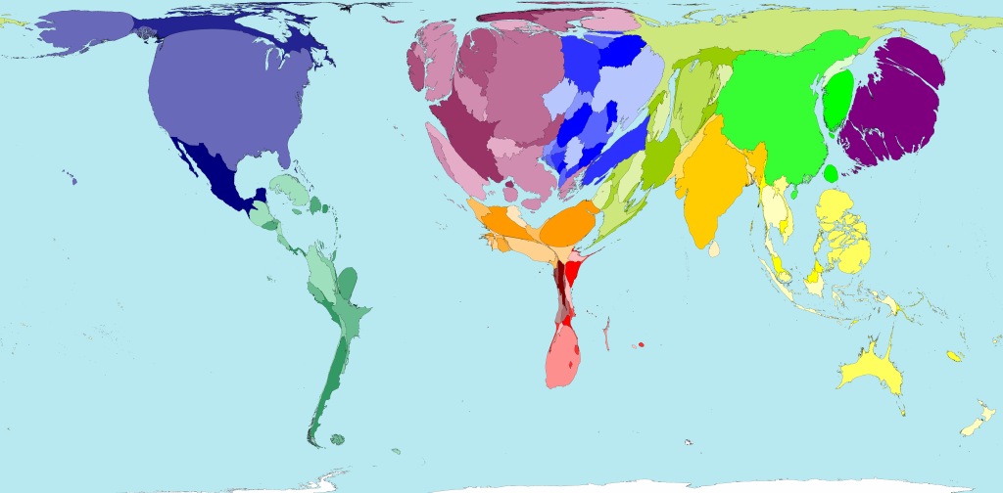
Nursing access

Slide 9
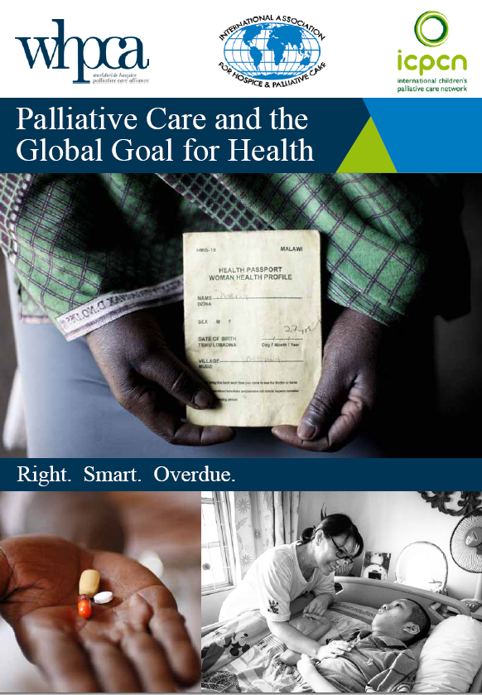
Global perspective; palliative care
Palliative care: essential contribution to global health
‘Citizens must empower themselves to work towards equitable access to palliative care as part of the Global Goal for Health’
KJackson. Dec 2015 Worldwide Hospice Palliative Care Alliance.

Slide 10
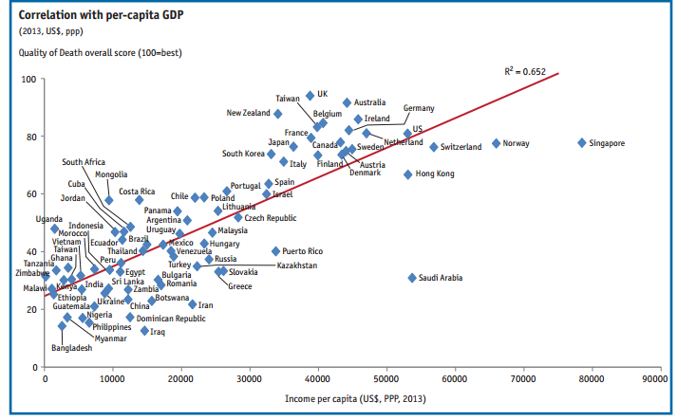
Global perspective; palliative care
Poverty; economic impact on quality of death
Quality of Death Index: The Economist Intelligence Unit 2015

Slide 11
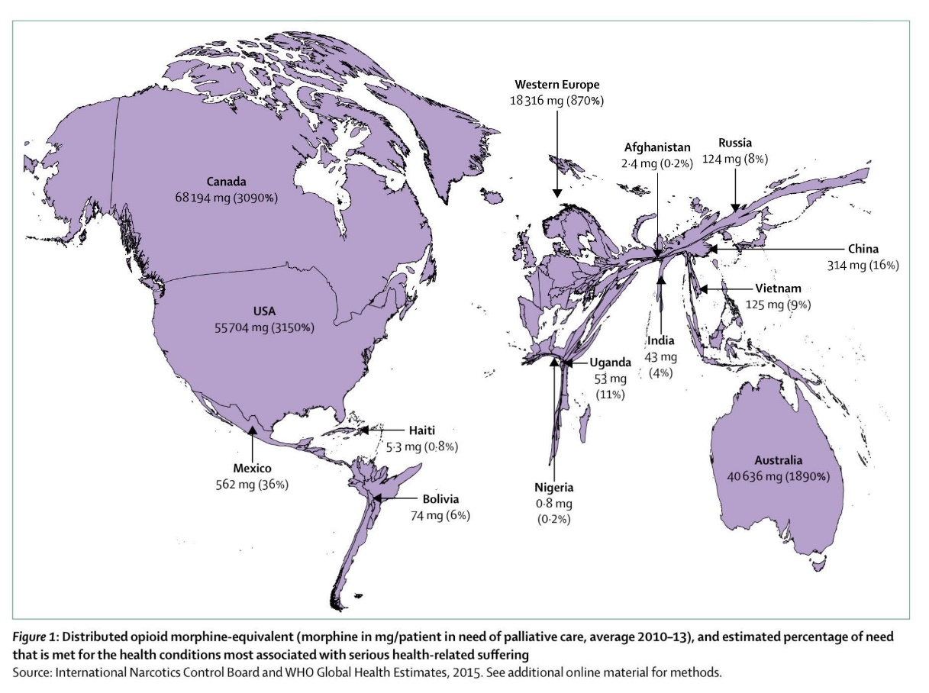
Global perspective; palliative care
Lancet Commission report Oct 2017
‘Alleviating the access abyss in palliative care and pain relief-an imperative of universal health coverage’

Slide 12

Global perspective; palliative care
WHA Resolution
  to develop, strengthen and implement, where appropriate, palliative care policies to support the comprehensive strengthening of health systems to integrate evidence-based, cost-effective and equitable palliative care services in the continuum of care, across all levels, with emphasis on primary care, community and home-based care, and universal coverage schemes
  June 2014
Notes:
Psychological, spiritual and social needs,

Slide 13
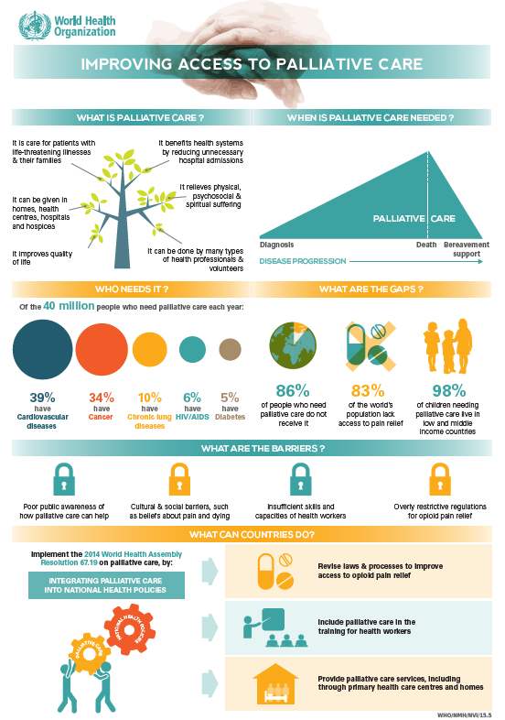
Global perspective; palliative care
  40 million in need each year
  barriers
    poor public awareness
    cultural and social issues
    inadequate capacity health care workers
    restrictive regulatory framework
  WHO fact sheet and infographic
  WHPCA global atlas
  WHPCA World Map PC development

Slide 14
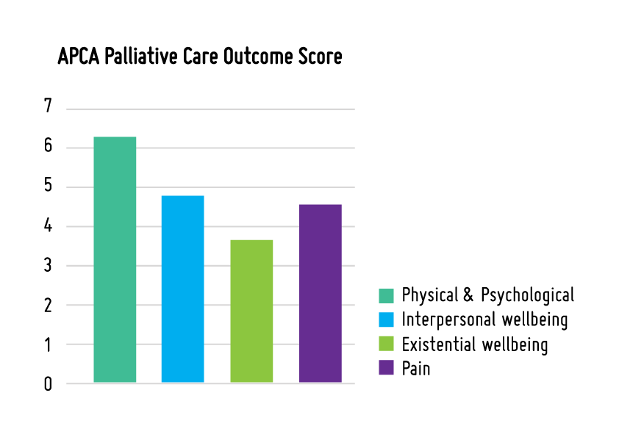
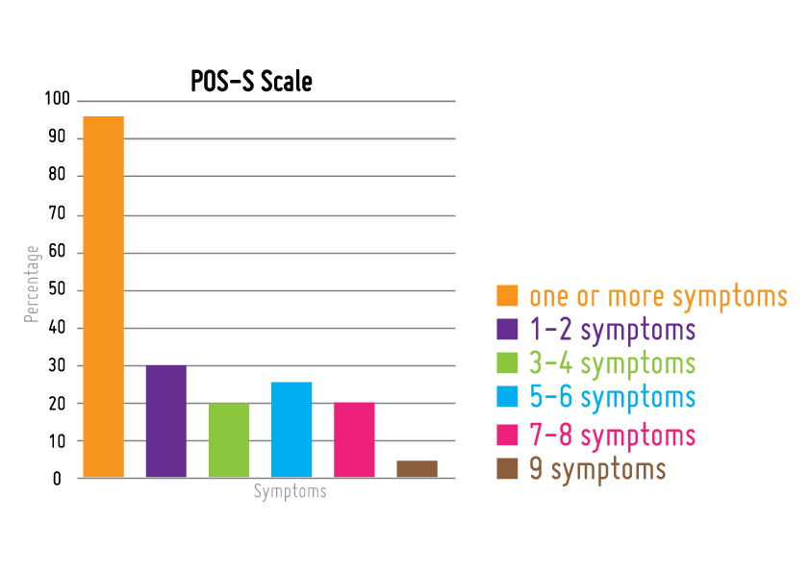
Palliative care needs
Point prevalence needs assessment studies Uganda
  national hospital 40%
  oncology settings 95%
  provincial hospitals 25%

Slide 15
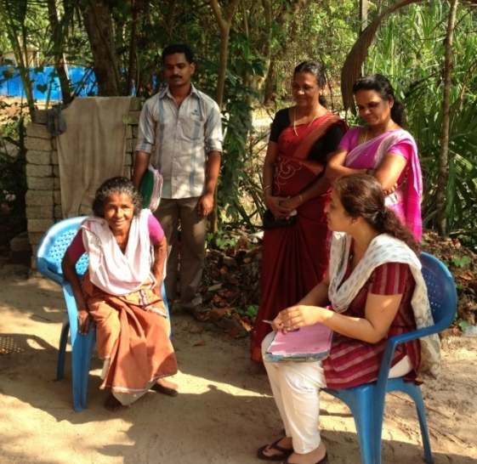

Palliative care needs
Hidden people
  older people and children
  chronic mental health
  dual epidemic with HIV
  prisoners, people with disabilities, sex workers, substance users, conflict areas
  poverty, geography, language and social exclusion
Grant L et al BMJ Supportive & Palliative Care (2011).

Slide 16
Partnerships for palliative care
Scotland is a leader in palliative care
  Contributed to global development
  Scottish NHS and community benefit from mutual learning
  innovation, creativity, use of scarce resources, cultural understanding, spiritual depth, common humanity, compassion, inspiration, skills transfer, joint research, motivation and renewed energy
  Global contributions to WHO, WHA, Planetary Health, IAHPC, Lancet Comission

Slide 17
Partnerships for palliative care
Many examples of creative partnerships
Global Palliative Care Day, Scotland Nov 29th 2018
  Cairdeas www.cairdeas.org.uk
  Global Health Academy University of Edinburgh www.ed.ac.uk/global-health
  Primary Palliative Care, Centre for Population Studies, University of Edinburgh www.ed.ac.uk/usher/primary-palliative-care
  EMMS www.emms.org
  PRIME www.prime-international.org
    Highland-Malawi; Glasgow-Bethlehem; St Columbas-Uganda;
  ….

Slide 18
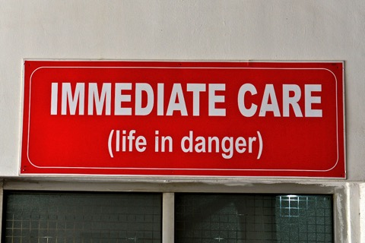
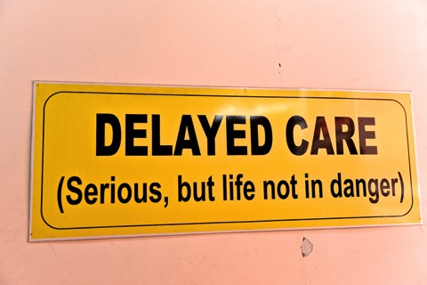
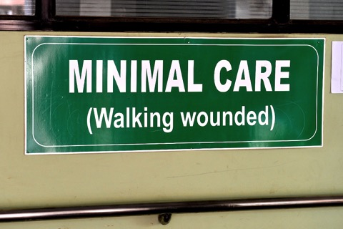
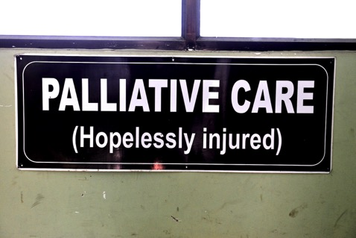
Notes:
Triage signs at Nepal Medical College Hospital

Slide 19
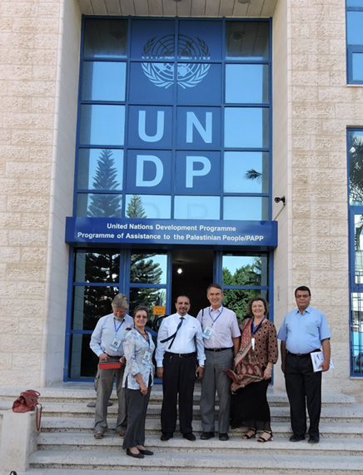
Partnerships for palliative care
Cairdeas International Palliative Care Trust
Global health Academy, University of Edinburgh
Health systems integration; Uganda, Rwanda, Zambia, Kenya, India, Mauritania
Curriculum development Uganda, Sudan, Rwanda, Gaza, Bethlehem
Advocacy; Gaza, West Bank, India
Humanitarian integration; Gaza, Northern Uganda

Slide 20
Lewington J, Namukwaya E, Limoges J, Leng M, Harding R. Provision of palliative care for life-limiting disease in a low income country national hospital setting: how much is needed? BMJ Support Palliat Care. 2012;2:140–4.
Grant L, Downing J, Luyirika E, Murphy M, Namukwaya L, Kiyange F, Atieno M. Kemigish-Ssali E, Hunt J, Snell K, Murray SA and Leng M. (2017) Integrating palliative care into national health systems in Africa: a multi-country intervention study. Journal of Global Health 7(1).
Namukwaya E, Murray SA, Downing J, Leng M and Grant L. (2017) 'I think my body has become addicted to those tablets'. Chronic Heart failure patients' understanding of and beliefs about their illness and its treatment: a qualitative longitudinal study from Uganda. PLOS One.
Namukwaya E, Grant L, Downing J, Leng M and Murray SA. (2017) Improving care for people with heart failure in Uganda: serial in-depth interviews with patients’ and their health care professionals. BMC Res Notes 10:184. DOI 10.1186/s13104-017-2505-0
Downing J, Batuli M, Kivumbi G, Kabahweza J, Grant L, Murray SA, Namukwaya E, Leng M (2016) Evaluation of a palliative care link nurse programme in Mulago hospital, Uganda: An evaluation using mixed methods. BMC Palliative Care 15:40 DOI 10.1186/s12904-016-0115-6
Downing J, Leng M and Grant L. (2016). Implementing a Palliative Care Nurse Leadership Fellowship Program in Uganda. Oncology Nursing Forum 43(3) 395-398. DOI: 10.1188/16.ONF.395-398
Downing J, Grant L, Leng M and Namukwaya E. (2015) Understanding models of palliative care delivery in sub-Saharan Africa: Learning from programmes in Kenya and Malawi. Journal of Pain and Symptom Management. 50(3): 362-370.
www.cairdeas.org.uk (all results in Resources section)

Slide 21
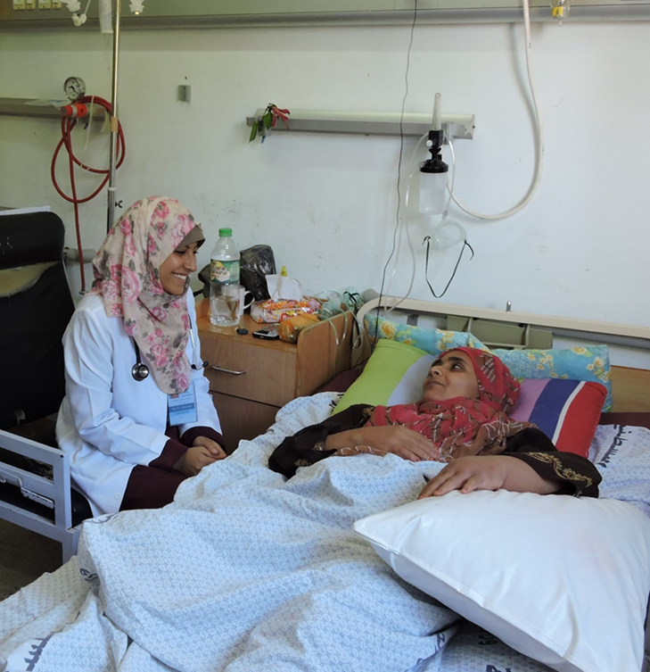

Transforming societies
A humanitarian doctor ‘We appreciate your initiative, it has been a key lacking point. Many times there is a patient crying in pain. The approach of integrating palliative care into the medical practices of prevention and cure is the way to go. The more people we train, the more people we will reach in community.’

Slide 22
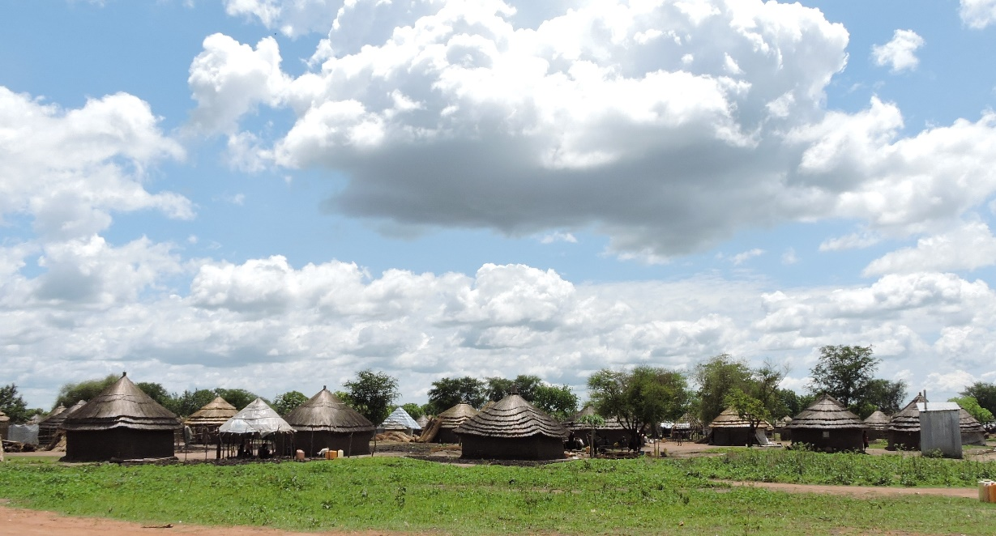
Transforming lives
Senior nurse in an Adjumani hospital: ‘Someone needs to speak for the voiceless. When help comes, people change. It is like losing hope — then hope appears suddenly like the sun.’

Slide 23
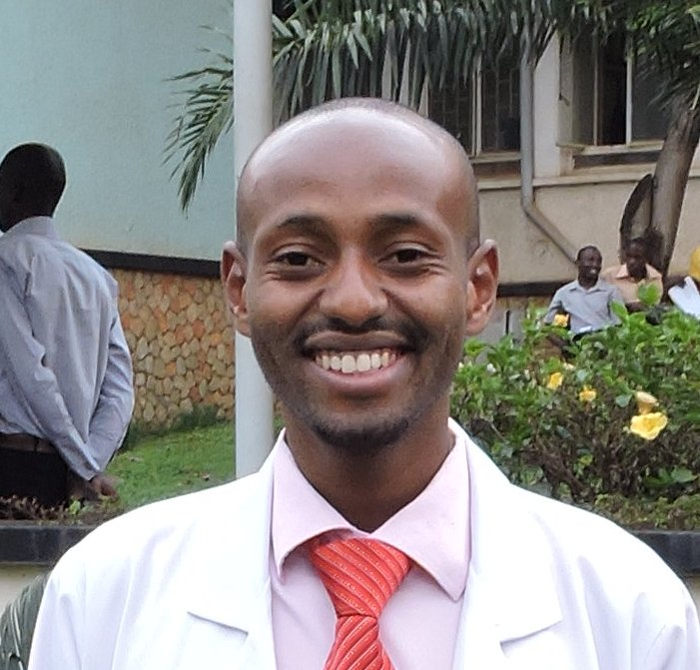
Transforming practice
  'The palliative care training has made a huge impact; I now see the patient as a person and not a disease, I don't avoid difficult conversations, I don't order unnecessary investigations, I see them as part of a family, I do holistic care. It was not like that before.' MMed doctor Makerere.

Slide 24
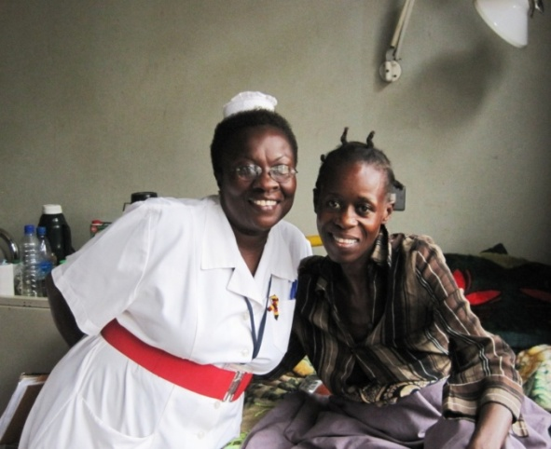
Transforming lives
‘you gave me hope, you gave me pain control, you gave me love....thank you and please pray for me...make sure everyone in Uganda has this care.’

Slide 25

Global palliative care
Many thanks

