Slide 1




Living and dying well with different illnesses; experiences of patients and carers
Dr Kirsty Boyd
Consultant in Palliative Medicine, NHS Lothian
Honorary Clinical Senior Lecturer
The University of Edinburgh
“Whatever the setting, care will be provided to the highest standards of quality and safety,
with the person at the centre of all decisions.”
2020 Vision

Slide 2
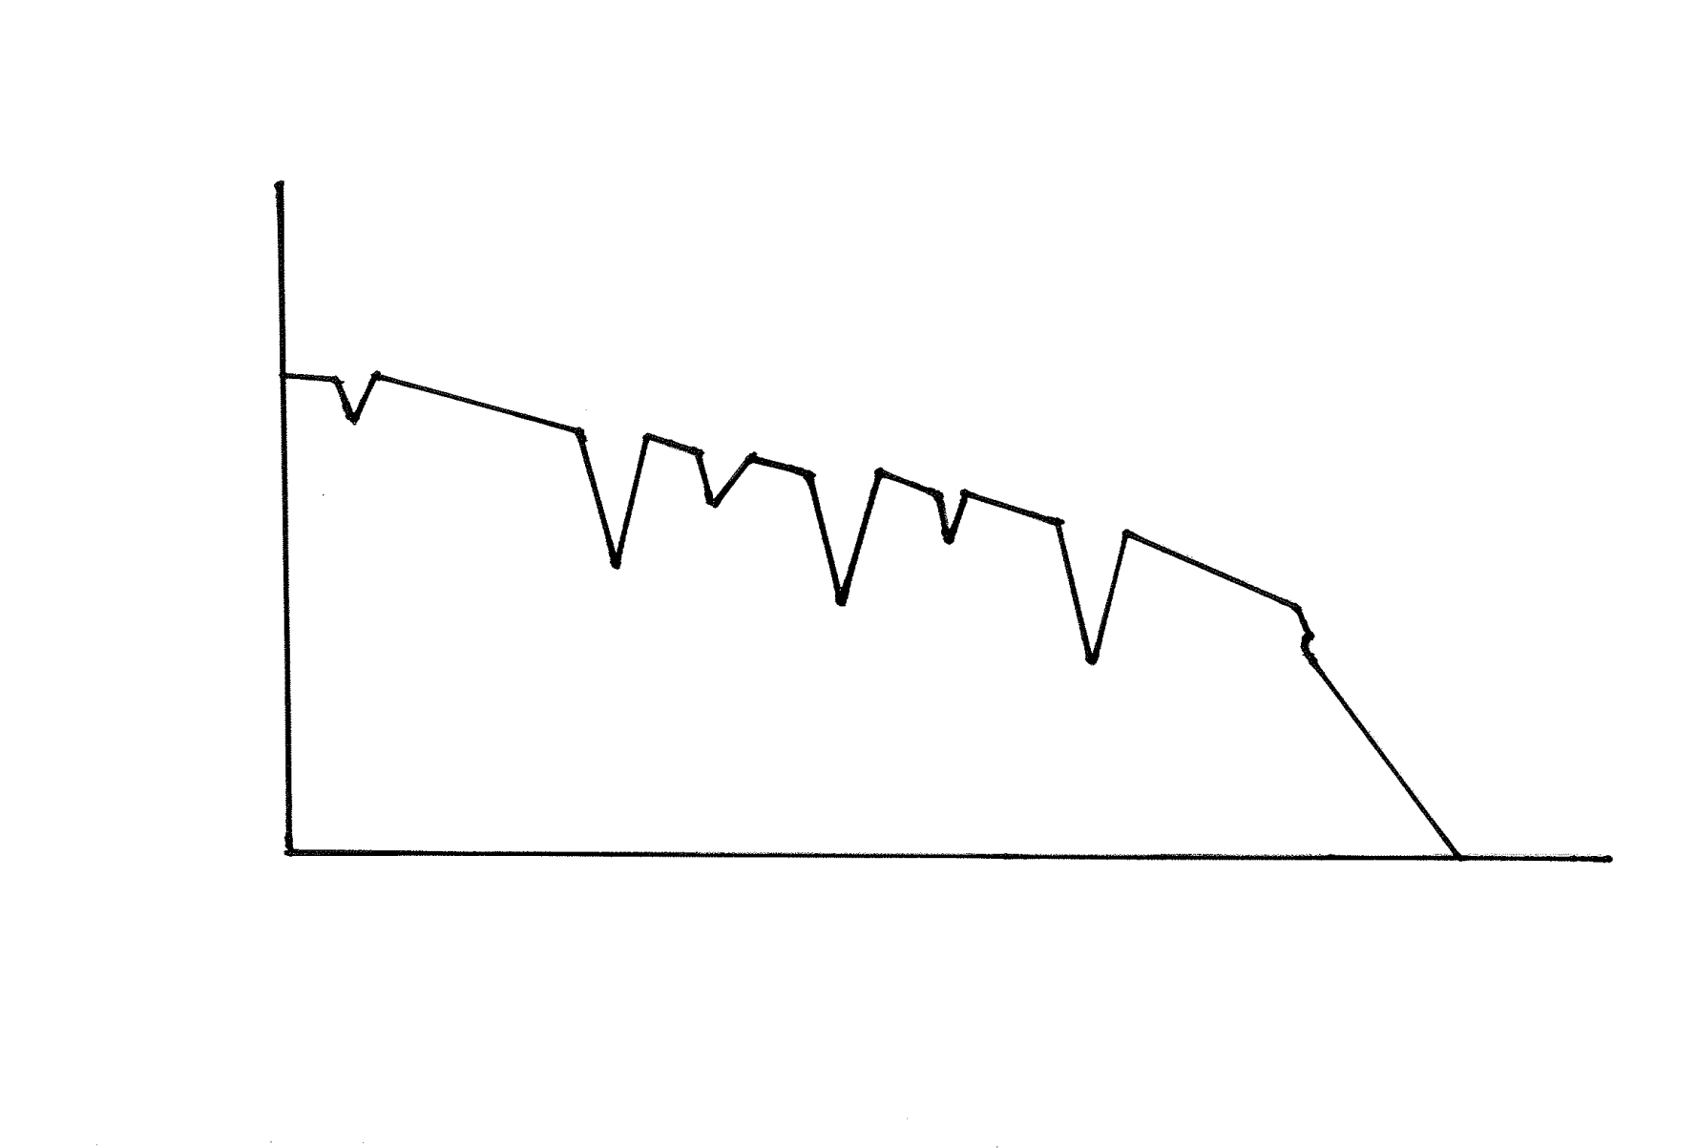
People’s journeys with advanced illness
Multimorbidity
65% aged 65+
>80% aged 85+
‘Living well’ with long term conditions
Deteriorating Health
‘Dying well’
Time
Best Supportive Care & Palliative Care
‘It could be another year or two or a week or two, who knows…..’
Barnett K, Mercer S, Norbury M et al. Lancet 2012;380:37-43.

Slide 3

Cancer narratives: dying v ‘fighting’
Beginning
I was scared when they told me when they said there was a tumour. It knocked me for six. I thought, O my God, I am going to die…
Mr C, patient with a brain tumour
Middle
I honestly sometimes think there’s nothing wrong with me….
Mr E, patient with lung cancer
End
The main thing is, how long am I going to live?
Ms I, patient with lung cancer

Slide 4
Living with organ failure: just managing
Beginning
How it started is anybody’s guess…Mr N, chronic lung disease
Middle
It’s one day on top and the next day back under again…Mr O, heart failure
“I’m not afraid to die, but I want to live.” Mrs J, heart failure
End
I know it won’t get better, but I hope it won’t get any worse…
Ms S, heart failure
As long as it just keeps working the way it is working I’ll be quite happy… Mr T, liver failure

Slide 5
Living with frailty: losing capacity and autonomy
Beginning It was all due to an accident [a fall] but I’ve never really been the same you see… Mr V Middle It’s just a gradual deterioration, you can’t expect anything else… Mr X “ Well it’s just part of getting old…” Mrs P End I said “I’m going home” I said “you’re no putting me into any [nursing] home” Mrs X

Slide 6
Experiences of people living with advanced illnesses
Hoping
Coping
Not ‘planning for death’
Patient: “I’ve never broached the subject (of dying) cause I think like I’d rather be positive. I think “I’m not going to get worse.” (Female, 66: Liver failure, diabetes, IHD)
Carer: ‘We deal with everything just as it is happening, just day to day stuff and things. We just manage.’ (Carer for male, 87: renal failure, diverticular disease, mild dementia, prostate cancer,)
“I am quite happy to just float along as we are doing now.“ (Female, 89: epilepsy, atrial fibrillation, hypertension, severe aortic stenosis)
Patient: ‘I’m not afraid to die but I want to live’ (Female, 79: stage IV heart failure, renal failure)
Mason B et al. BMJ Supportive Palliative Care 2014;0:1–6. doi:10.1136/bmjspcare-2013-000639

Slide 7
Talking about ‘What Matters’
Future Care Planning
Advance care planning (ACP)
‘If and When’ plans
Anticipatory care planning (AnCP)
‘What we’ll do if’ plans
Final days of life planning
‘What matters now’ plans
What do you know?
What are you expecting?
What’s happening?
What matters?
What would help?
Plan the discussion
Previous plans
Key people
Urgency
Capacity
Understanding/ readiness (prognostic awareness)
What we could do…

Slide 8
Talking about future care together √
Generalisation
  Sometimes people want to choose a family member or a close friend to make decisions for them if they get less well in the future. Have you thought about that
Hypothetical questions
  If you were less well again like this in the future what do you think we should do?
Hope linked with concern
  We hope the (treatment) will help, but I am worried that at some stage, maybe even soon, you will not get better…. What do you think?
  I wish we had treatment for, but …
Accept uncertainty, change and diverse views
  Can we talk about what is most important for you now, and how we might cope with not knowing exactly what will happen and when?

Slide 9
Talking about future care together X
  Euphemisms or long, vague explanations
    causes confusion
  Talking about ‘trying’ or ‘the chances’ if a treatment will not work or have a very poor outcome
    directs people to ‘want everything done’
  Using language such as ‘futile’, ‘ treatment limitation’ or ’ceiling of treatment/care’, terminal, ‘made palliative’
    can make people think ‘nothing will be done for them’
  Moving on to treatment options and planning care before understanding what matters to this person and those close to them
    People need to have a realistic understanding of their situation to formulate goals, then they can take part in decisions about options for treatment / care which fit with ‘what matters’ most to them.

Slide 10


Diagnosis of a new illness
Deteriorating health

Slide 11
And write these poems, which are funeral songs
That have been taught to me by vanished time:
Not only to enumerate my wrongs
But to pay homage to the late sublime
That comes with seeing how the years have brought
A fitting end, if not the one I sought.
Clive James New Yorker, May 28, 2013
Medicine is a science of uncertainty
and an art of probability.
William Osler

