Slide 1





Choices and decisions towards the end of life
Annual Conference 2014
#sppc2014
RCPE-WIFI
Password: chiron1681

Slide 2

How can improvement science make NHS Scotland safer and more compassionate?
Jason Leitch
Clinical Director
The Quality Unit, Scottish Government
@jasonleitch

Slide 3
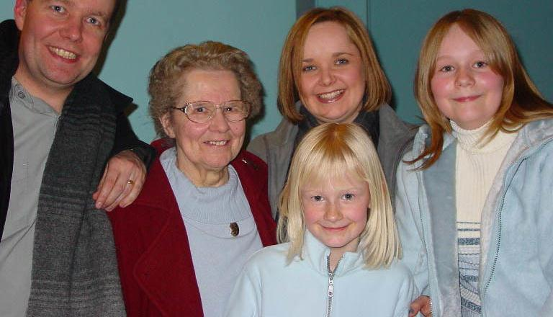

Slide 4
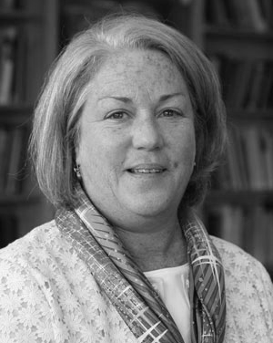
A Powerful Evolution
“Do it to me.
Do it for me.
Do it with me.”
Martha Hayward
Patient Advocate
Notes:
Martha Donovan Hayward joined the Institute for Healthcare Improvement (IHI) in March 2011 as the Lead for Public and Patient Engagement. The focus of her work at IHI is to bring patients and families into the design of all work at IHI to accelerate improvement by engaging patients and their families at all levels of care, design and decision making. A cancer survivor herself, she is a founding board member of the nonprofit Women’s Health Exchange and served on the Patient and Family Advisory Council of Dana-Farber Cancer Institute in Boston. Her career experience includes over 20 years in communications, marketing and fundraising in the areas of health, politics, and education. Most recently, as Executive Director at The Partnership for Healthcare Excellence, she brought a particular focus on, and considerable experience in, the area of patient advocacy.

Slide 5
How do we do this everywhere, all the time?

Slide 6
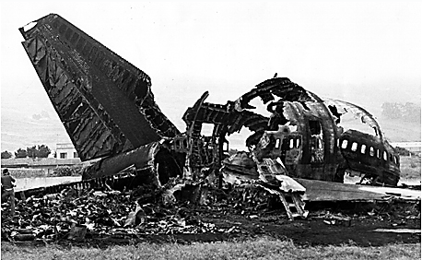
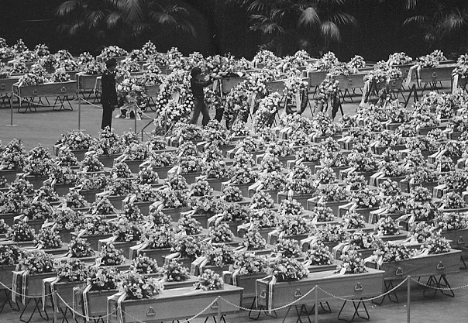
Associated Press

Slide 7
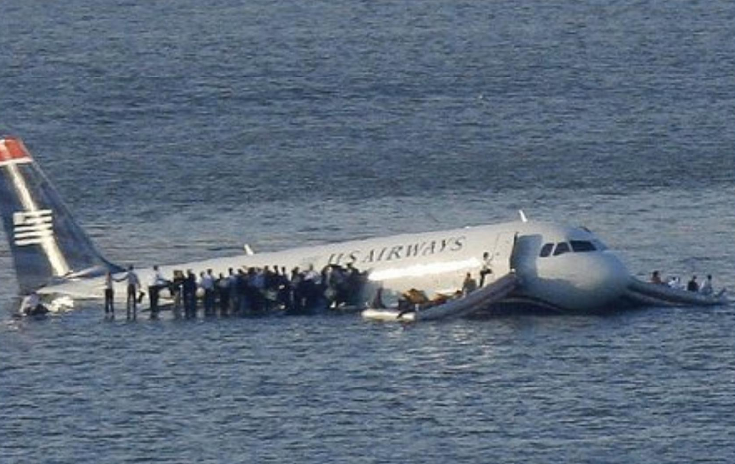
Reuters

Slide 8

What made the difference?
1. Checklists
- technical accuracy
2. Crew Resource Management
- human factors

Slide 9

Definition of
Reliability for Health Care:
Failure free operation over time
David Garvin
Harvard Business School

Slide 10

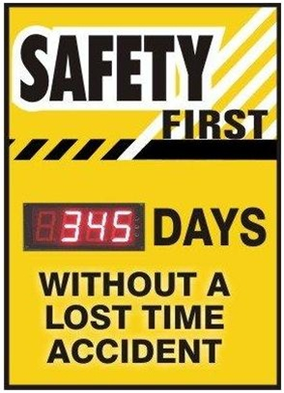
Moving from Never Events…

Slide 11

To Always Events…

Slide 12

Reliably make sure that conversations about end of life care actually happen
This is discussed by the
multidisciplinary team
Everyone knows the outcome
of this conversation

Slide 13
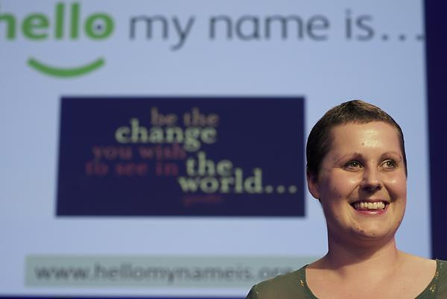

Slide 14

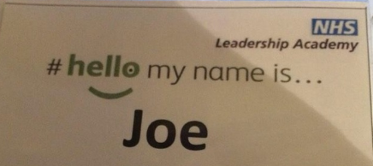
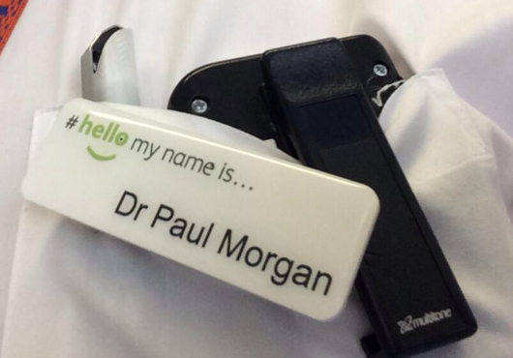
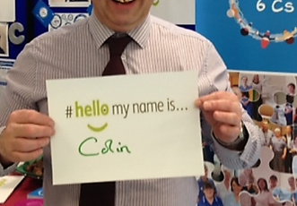
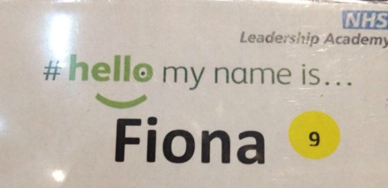

Slide 15

The Reliability Gap
Current Improvement methods in healthcare are highly dependent on vigilance and hard work
Permissive clinical autonomy creates and allows wide performance margins
The focus on outcomes tends to exaggerate the reliability within healthcare giving clinicians a false sense of security
Notes:
Current Improvement methods in healthcare are highly dependent on vigilance and hard work
The focus on outcomes tends to exaggerate the reliability within healthcare giving clinicians a false sense of security
Permissive clinical autonomy creates and allows wide performance margins

Slide 16
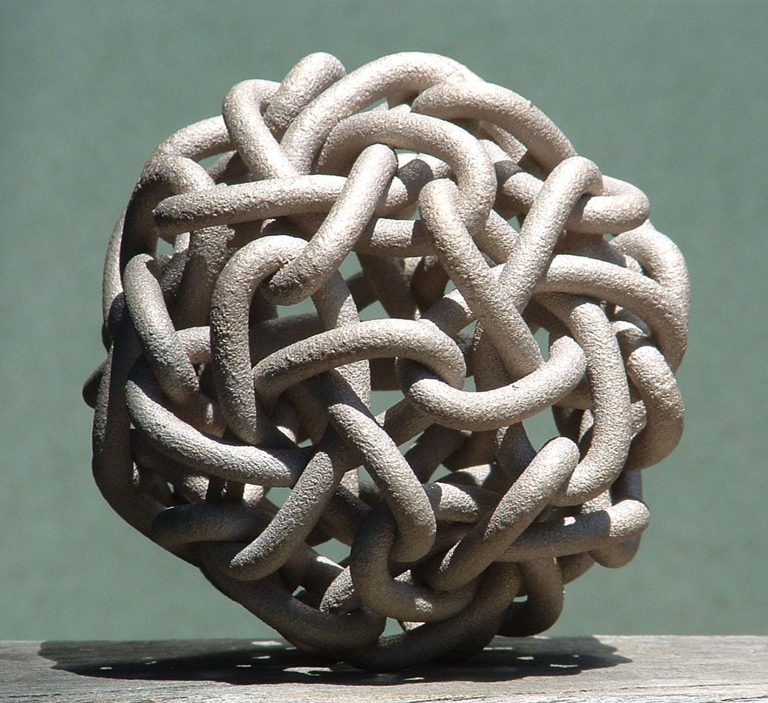

Slide 17
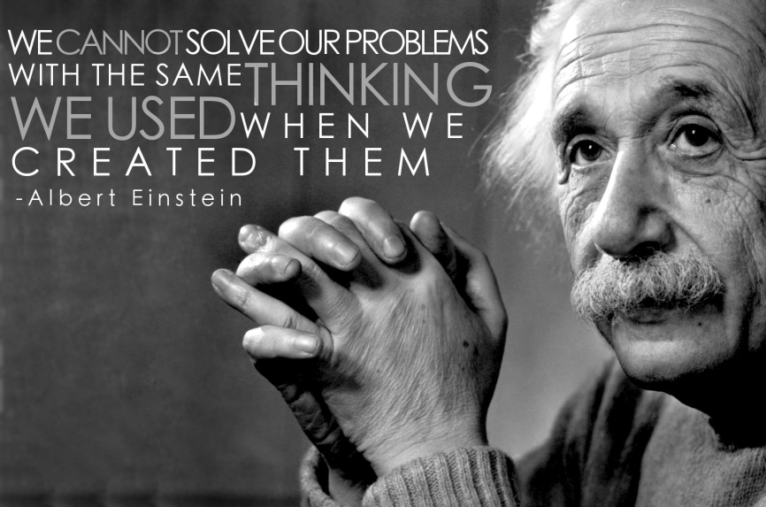

Slide 18
Implementing at scale…. can it be done?
Will
Ideas
Execution

Slide 19
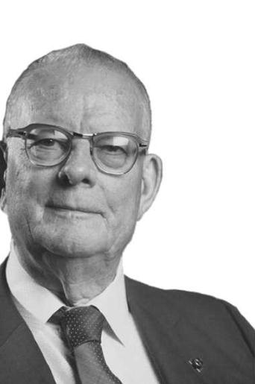
“By what method?... only the method counts”
W Edwards Deming

Slide 20



The Typical Approach…
Conference Room
APPROVE
DESIGN
DESIGN
DESIGN
DESIGN
Real World
IMPLEMENT
Notes:
Traditionally we have not been good at making change for improvement reliable – because we have not tested whether it will be delivered appropriately in various conditions and environments before we expect all to implement and make part of every day business.
e.g. previous experience of launching new protocols/guidelines – as of Mon am….. expect all to comply fully without really knowing that it’s practical for every system – then we wonder why people don’t comply and the system is unreliable.

Slide 21

The Quality Improvement Approach
Conference Room
DESIGN
APPROVE
IF NECESSARY
Real World
START TO IMPLEMENT
TEST & MODIFY
TEST & MODIFY
TEST & MODIFY
Notes:
Traditionally we have not been good at making change for improvement reliable – because we have not tested whether it will be delivered appropriately in various conditions and environments before we expect all to implement and make part of every day business.
e.g. previous experience of launching new protocols/guidelines – as of Mon am….. expect all to comply fully without really knowing that it’s practical for every system – then we wonder why people don’t comply and the system is unreliable.

Slide 22

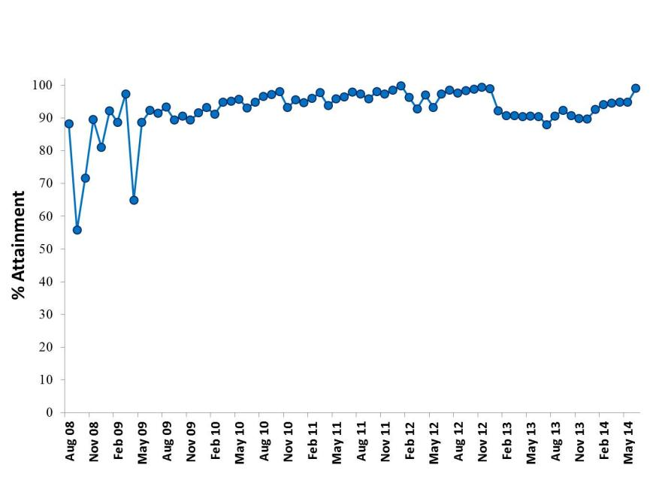
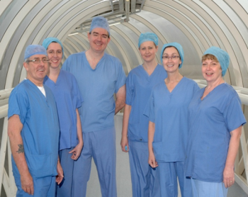
NHSScotland Surgical
Safety Briefings
Notes:
Data from at least 9 out of 10 Boards with Data available on Extranet. Each month has an average sample size of 2949 procedures

Slide 23

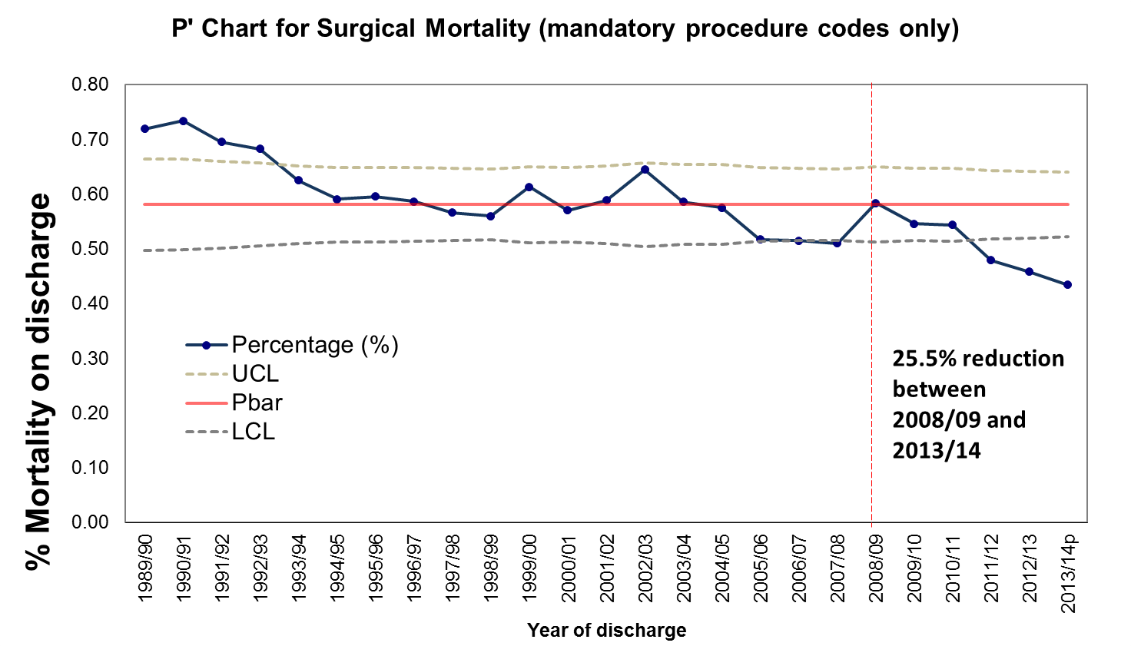
NHSScotland Surgical Mortality
Notes:
Updated!

Slide 24
Hospital Standardised Mortality Ratio
Scotland: October 2006 to March 2014
14.4% reduction

Slide 25
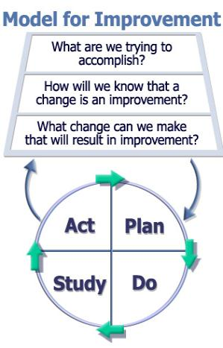
The Model for Improvement
Notes:
MFI is made up of 2 parts – the thinking part and the doing part
The 3 questions – the thinking part prepares you for the test by asking the ‘so what’ question
They need to be thought through, answered and written down by the improver to ensure that they, and therefore their colleagues, are clear on the benefits to them and their work.
That message often gets lost in the many things we are expected and asked to do and is one of the reasons why so many interventions are not implemented reliably.
If we are not clear on the benefits of something we are much less likely to do it.
The Plan Do Study Act cycle is a simple tool that’s used to test out ideas that will improve your systems and processes while learning what works and doesn’t work.
It’s a structured approach for making small incremental changes to systems that allow you to test on a small scale, learn from successes and failure and redesign as you go
It builds learning and buy in incrementally as tests ramp up and allows clinicians knowledge about their own system is built in to the process

Slide 26
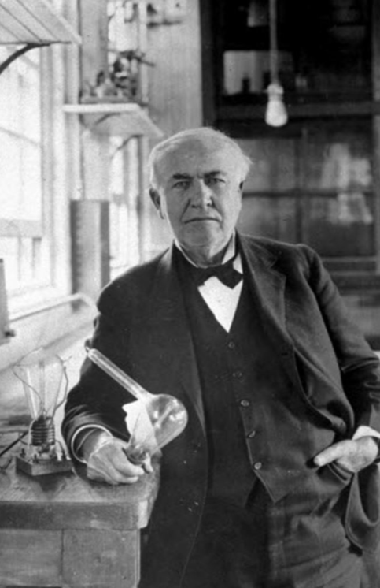
“I did not fail one thousand times; I have found one thousand ways that won’t work.”
Thomas Edison
Notes:
When asked by a critical journalist how it felt to have failed 1000 times, Edison is said to have replied…

Slide 27
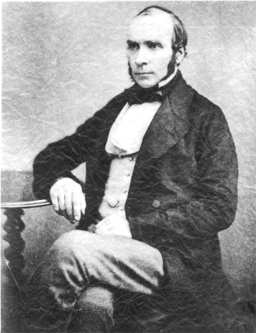
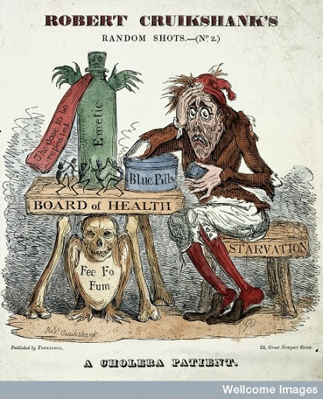
The Power of Accurate
Information
Notes:
In the world of the 1850s, cholera was believed to be spread by miasma in the air, germs were not yet understood and the sudden and serious outbreak of cholera in London's Soho was a mystery.
So Snow did something data journalists often do now: he mapped the cases. The map essentially represented each death as a bar,
It became apparent that the cases were clustered around the pump in Broad (now Broadwick) street.
There were some outliers though and Snow wrote that:
In some of the instance , where the deaths are scattered a little further from the rest on the map, the malady was probably contracted at a nearer point to the pump
One 59-year-old woman sent daily for water from the Broad street pump because she liked its taste. Wrote Snow:
I was informed by this lady's son that she had not been in the neighbourhood of Broad Street for many months. A cart went from broad Street to West End every day and it was the custom to take out a large bottle of the water from the pump in Broad Street, as she preferred it. The water was taken on Thursday 31st August., and she drank of it in the evening, and also on Friday. She was seized with cholera on the evening of the latter day, and died on Saturday
At a local brewery, the workers were allowed all the beer they could drink - it was believed they didn't drink water at all. But it had its own water supply too and there were consequently fewer cases.
In nearby Poland street, a workhouse was surrounded by cases but appeared unaffected: this was because, again, it had its own water supply.
It turned out that the water for the pump was polluted by sewage from a nearby cesspit where a baby's nappy contaminated with cholera had been dumped. But he didn't just produce a map; it was one part of a detailed statistical analysis.
As the Public Health Perspectives blog says, it changed how we see data visualisations, and how we see microbes.

Slide 28
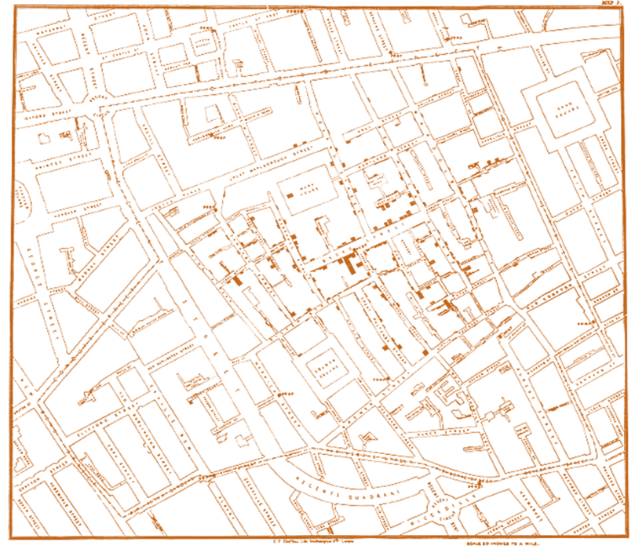


The Power of Accurate
Information

Slide 29
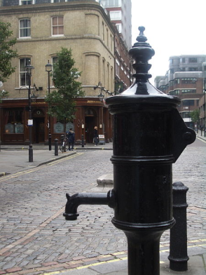
The Power of Accurate
Information

Slide 30
Why its important to measure the right things, right

Slide 31


Slide 32
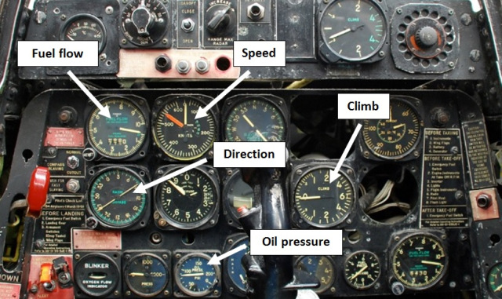
The right measures are the ones derived from purpose…
Simon Guilfoyle, 2013
Notes:
You can see that it’s pretty useful stuff – how fast the plane is flying, what direction it’s heading, how the oil pressure is doing, and so on. All linked to purpose – in this case to fly passengers safely to their destination. The method by which the information is relayed to the pilot is useful too – the dials are capable of indicating change in real time, enabling our pilot to respond accordingly and make adjustments if necessary.

Slide 33
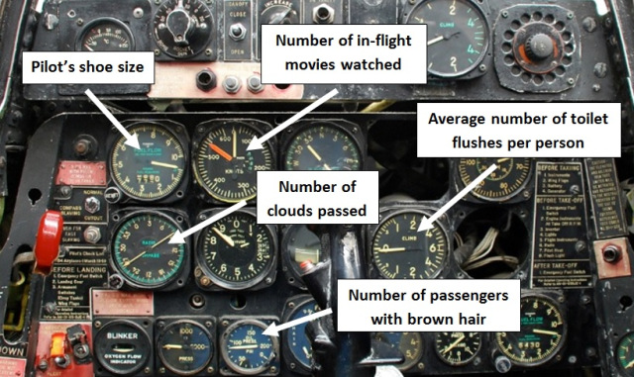
What if you use the wrong measures?
Simon Guilfoyle, 2013
Notes:
Well here’s the same set of dials, this time configured to measure the wrong things. Using the wrong measures means it’s impossible to establish if you’re achieving purpose. There’s no point counting the wrong things, just because they’re easy to count. Furthermore, if you’re using the wrong measures, don’t expect them to encourage the right behaviours.

Slide 34
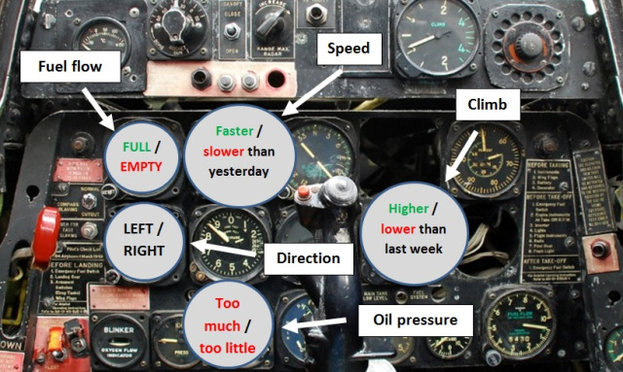
What if you measure the right things, but in the wrong way?
Simon Guilfoyle, 2013
Notes:
Here’s the ‘binary comparison’ version of the cockpit dials. All the same measures as in the original configuration, but presented in a way that can’t tell you anything useful.

Slide 35
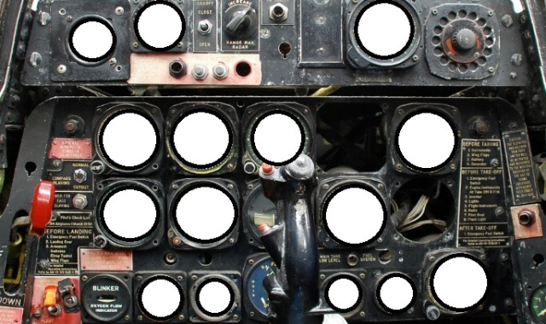
And if we didn’t measure anything?
Simon Guilfoyle, 2013
Notes:
I wouldn’t want to be a passenger on that plane.

Slide 36
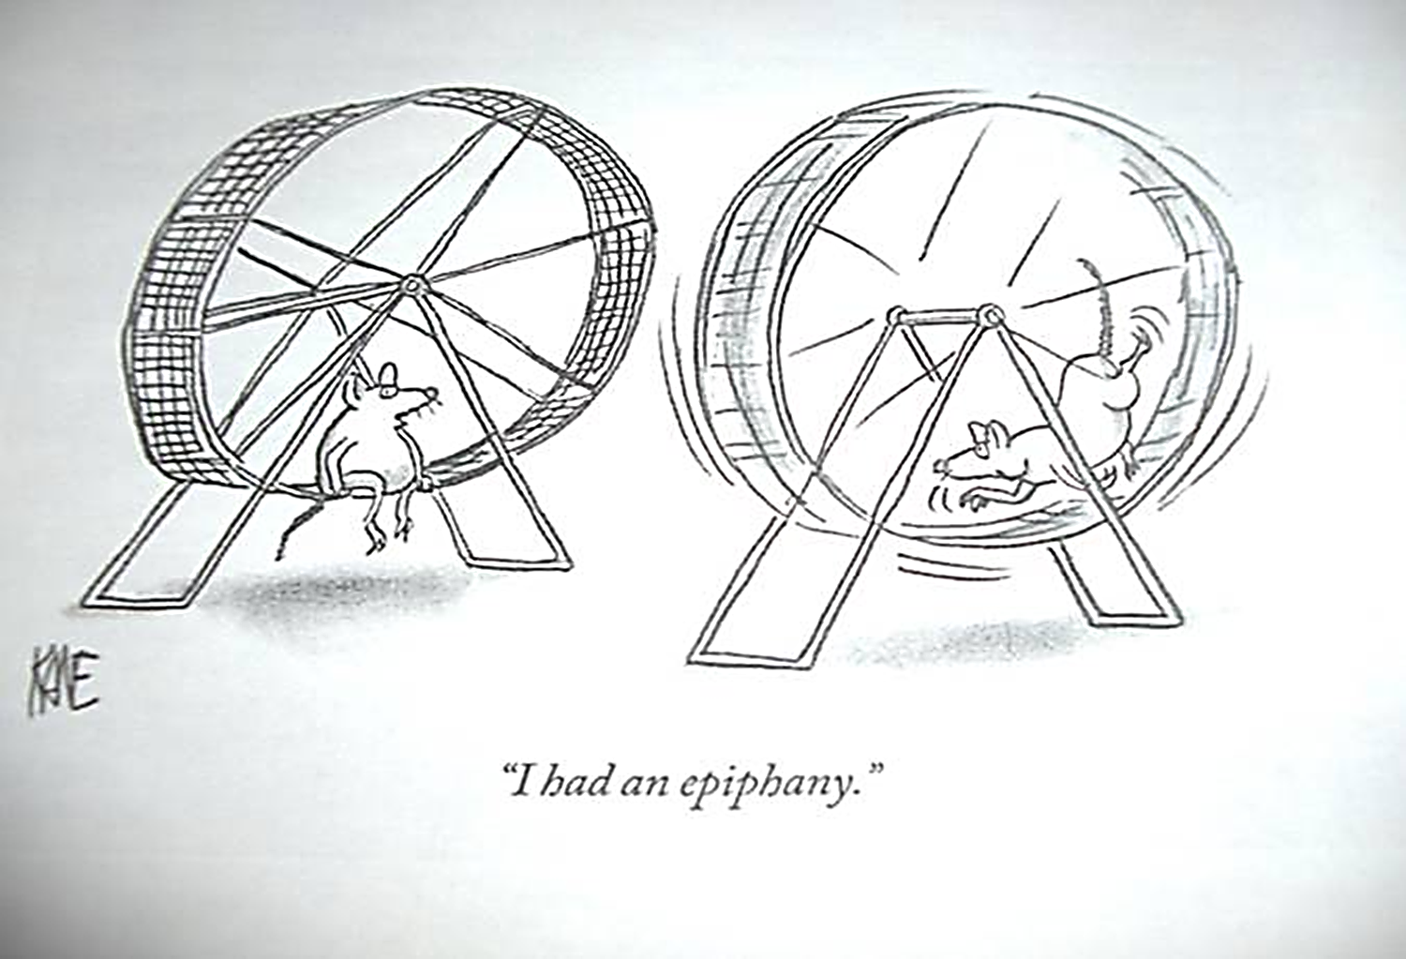
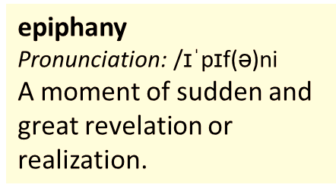
“I had an epiphany”

Slide 37
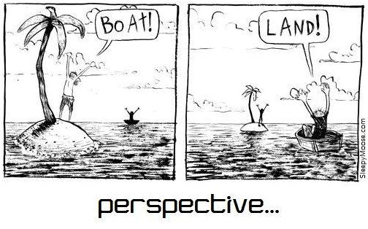
Notes:
A potential flipping slide? Changing our perspective….
Notes on the American approach to “flipping healthcare”:
The traditional doctor’s visit is ripe for reinvention - it is such a valuable interaction.
New tools, technologies, and strategies can empower people to be more informed and more engaged when they walk into the doctor’s clinic and better equipped to improve their health when they walk out the door.
Doctors, nurses, and other care providers can improve the ways they communicate and engage with patients during visits.
Healthcare providers need to take advantage of new tools for monitoring, supporting, and connecting with their patients outside of the office, too.
Tapping into these strategies could turn the provider-patient interaction on its head—and promote better, more meaningful relationships..

Slide 38


Slide 39
From:
“What’s the matter?”
To:
“What matters to me?”
Notes:
Led by the play service, the children make a poster/drawing of what matters to them and staff stick it up on the wall close to their bed so that everyone knows a bit more about them.
Listening to the patient voice.

Slide 40


Slide 41
Kendra
7 year old
Severe autism
Notes:
Kendra has severe autism and is unable to speak or write but can make noises. Her dad did this attached 'what matters to me'
By the afternoon he had a collapsed and had to be taken by ambulance to Hospital. Kendra was left on her own in the hospital. The team said ' if we didn’t have the 'what matters to me' we wouldn’t have known how Kendra communicates, we wouldn’t have understood properly how to care for her' ' we would never have known to watch out for her 'making a run for it!' ' we were prepared for her not liking her medicines and let her touch our hair as a way of communicating' ' we managed to keep her calm and everything went well despite her dad being in hospital'
'with out what matters to me we wouldn’t have been able to do this'

Slide 42

Kendra

Slide 43
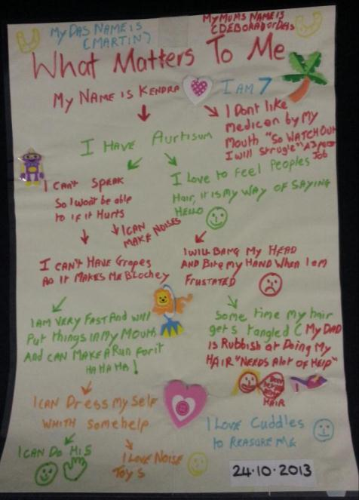
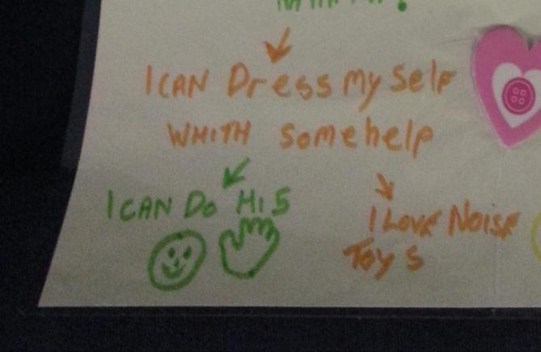
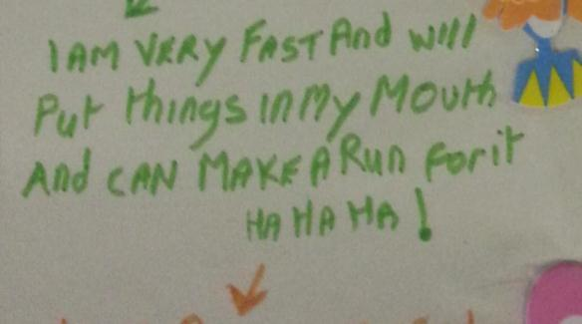
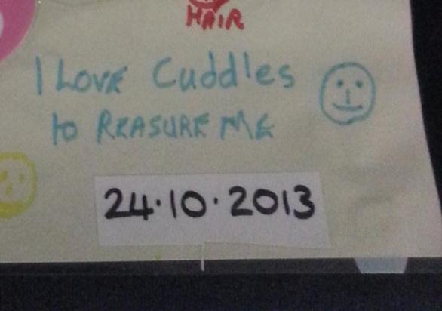
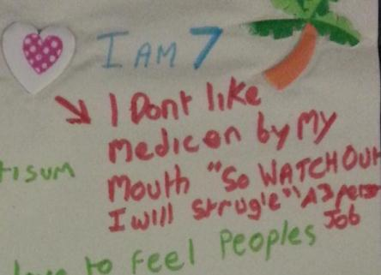

Slide 44

Notes:
Over the past few months, “What Matters to Me” has started to spread from children’s services to older people’s services, learning disability services, across adult care and further.
A lady was admitted to the Southern General Hospital with dementia, and was obviously very unhappy. She was agitated, restless and frequently getting up out of bed and wandering about - risking that she might fall. She was put on close supervision (?) for her own safety. They were piloting “What Matters to Me” in the ward at the time, and a nurse spent some time with this lady to find out about what mattered to her. It turns out that she liked to have her rosary beads with her at all times.

Slide 45
“I stopped seeing the patient, and started seeing the person”
Notes:
Following discussions with another lady about her past life in Sao Paulo, “I stopped seeing the patient, and started seeing the person”

Slide 46

The first choice we make each and every day is, "Will we act upon life, or will we merely be acted upon?"
Stephen Covey

Slide 47
Circle of Concern
Circle of Influence
Stephen Covey: The 7 Habits of Highly Effective People (1989)
Notes:
The Circle of Influence
All of us have a wide range of concerns in our lives – our housing, our health, our friends and family, the environment, the price of a
pint of beer, how to lose weight, animal rights, how to put on weight, sex and drugs and rock and roll, third world debt...
Within this whole universe of our concerns, there are some things we can influence and some things we can only stay concerned
about.
Now we have a choice about where we focus our attention and energy.
We can choose to focus all our attention on the area that is outside our influence.
We can get annoyed about the shortcomings of other people, we can blame the government, global capitalism, the weather, a rotten childhood,
bad luck, or fluoride in toothpaste. This focus leads to more and more blaming and accusing, to feelings of victimisation, ‘poor me’.
This negative way of thinking, accompanied by inaction to change things, results in the circle of influence shrinking.
Alternatively we can choose to focus on things that we can influence. This does not mean just the more immediate or ‘trivial’ concerns. It might mean focusing on those aspects of really huge problems that we can exert some influence over. And ‘influence’ does not mean direct ‘control’; we can influence things in an indirect way, for example in our own personal, daily behaviour.
By focusing attention and energy on our circle of influence, we become increasingly proactive. The energy we expend is enlarging; each little victory motivates us to find new ways of exerting influence. We don’t waste energy on things we can do nothing about, but direct it towards what we can change. With each step we feel stronger and more creative. And so our circle of influence expands.
It often happens that, in widening our circle of influence, we also widen our circle of concern. It becomes worth caring about some of the really challenging things in our world if we learn we can influence them.
It can be incredibly liberating to realise that, in choosing how to respond to circumstances, we affect those circumstances.

Slide 48
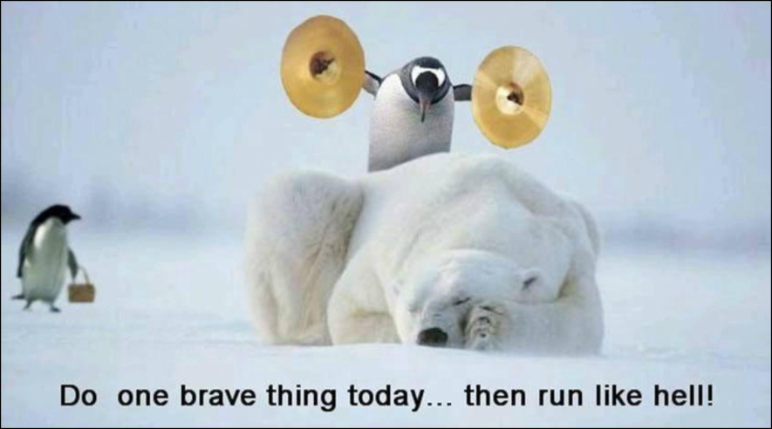

Slide 49

@jasonleitch

Slide 50
Choices and decisions towards the end of life
Annual Conference 2014
#sppc2014
RCPE-WIFI
Password: chiron1681

