Slide 1

Hospice funding – current challenges
Jacki Smart, CEO ACCORD Hospice
Chair of Scottish Hospices Leadership Group

Slide 2



Funding Hospices…

Slide 3
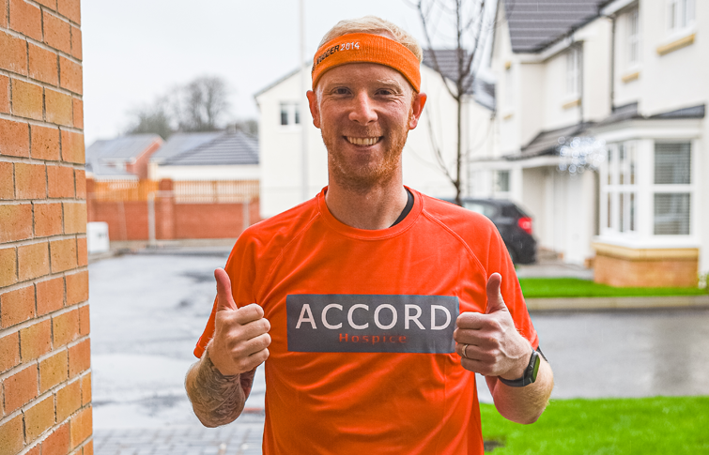
Funding Hospices…

Slide 4


Pressures…

Slide 5

Biggest Challenge for many…

Slide 6

Biggest Challenge for many…

Slide 7

Biggest Challenge for many…

Slide 8

Biggest Challenge for many…

Slide 9
Impact……
INEQUITY
LACK OF CHOICE
DISTRACTION
SUSTAINABILITY ?
No INNOVATION/ GROWTH
PRESSURE ON STAT PARTNERS

Slide 10



Solutions…

Slide 11
