Slide 1

www.ihi.org
A leading innovator, convener, partner, and driver of results in health and health care improvement worldwide. IHI's work is focused in five key areas:
Improvement Capability
Person- and Family-Centered Care
Patient Safety
Quality, Cost, and Value
Triple Aim for Populations

Slide 2
Deteriorating patient work
Scottish Patient Safety Programme
Acute adult
Maternity & children
Mental Health
Primary Care
www.scottishpatientsafetyprogramme.scot.nhs.uk

Slide 3
Conversation Ready Health Care Community
Engage with all patients and families to understand what matters to them at the end of life;
Steward this information as reliably as we do allergy information;
Partner with patients and families to develop appropriate goals of care at the end of life;
Exemplify this work in our own lives, so that we understand the benefits and challenges; and
Connect in a manner that is culturally and individually respectful of each patient and their family.

Slide 4

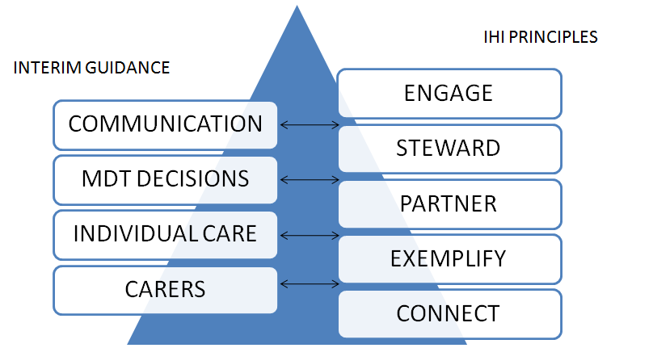
NHS Scotland

Slide 5

Partnership
Participation in monthly international calls for experience sharing and information transfer
Dedicated 3 weekly Scotland calls including all 3 pilot sites and colleagues from IHI
Individual monthly calls between NHS Boards and IHI colleagues
Monthly reporting to IHI and NHS Scotland Project Board
All Scotland sites meeting scheduled 17 September 2014

Slide 6
Next steps
Continued development of data capture specification with IHI
Ongoing PDSA cycles to test change, record results and improve next time
Data and information provision and sharing with IHI colleagues
All teach/all learn – spread and share within pilot board areas and beyond
Measurement of improvements made (eg quantification of reduced emergency call outs, inappropriate CPR attempts, how often patients wishes were met)

