Slide 1

Working towards a national strategy for palliative and end of life care in Scotland: considerations, evidence and actions
Professor David Clark
School of interdisciplinary Studies
University of Glasgow
December 2014

Slide 2
Global trends
End of life care will have major importance in the 21st century, as the population ages and as individual patterns of disease, symptoms and disability in later life become more complex.
European Union - those aged over 65 years in the total population is projected to increase from 84.6m in 2008 (17.1%) to 151.5m by 2060 (30.0%).
Global projections - people aged over 80 worldwide, will increase from 102m in 2009 to 395m in 2050.
Recent estimates suggest that 91m people will die worldwide in 2050, compared to 56 million in 2009 (44m of these in LMIC).
For each death c. five persons waffected by care-giving and grieving, so by the second half of the century some half a billion each year will experience the death of a person close to them.
When will we reach ‘peak dying’? How will death and dying on this scale be supported?

Slide 3
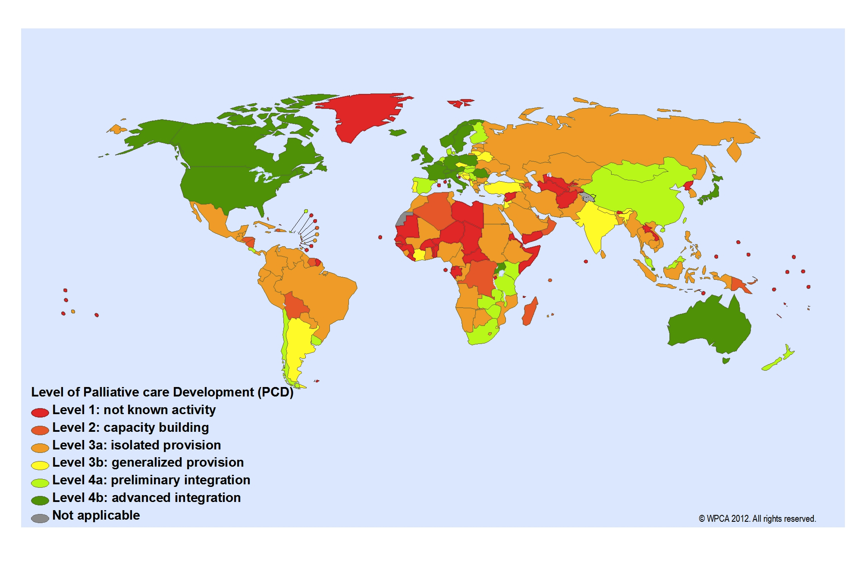
Global palliative care development: 2012

Slide 4
Barriers
Global indifference to the need for palliative care
Societal problems relating to public health, culture, education, attitudes, demography, social exclusion, religion, and social class
Organisational factors including service configuration, access and availability, sustainability, funding and workforce capacity
Professional concerns relating to levels of palliative care delivery, education, training and attitudes
Individual issues including disease status, personal beliefs and choices
Graham, F Kumar, S and Clark, D (2010) Barriers to the delivery of palliative care. In G Hanks et al Oxford Textbook of Palliative Medicine, 4th edition. Oxford: Oxford University Press, pp 125-134

Slide 5
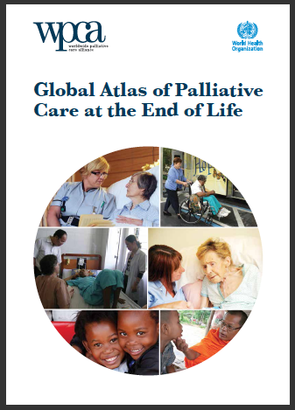
Global Atlas - from WHO and WPCA
Published January 2014
Basis of WHO resolution adopted by the World Health Assembly May 2014
Develop policies to integrate PC into health systems
Ensure adequate domestic funding
Integrate training into curricula
Assess domestic palliative care needs
Review and revise drug control legislation and add PC medications to essential medicines lists …
Full text of the resolution: http://goo.gl/d6ctbO

Slide 6

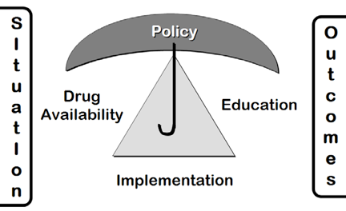
WHO Public Health Model of Palliative Care Development
Stjernsward J, Gómez‐Batiste X. (2008 )

Slide 7

‘New’ public health model
Population health approach involving education and community development
Primary health care approach involving non-specialist providers
Tertiary approach involving specialist health providers ﻿
Key principles: participatory, co-production, partnership, social capital, resilience, ecological setting
Volunteer ‘get together’ Kerala

Slide 8
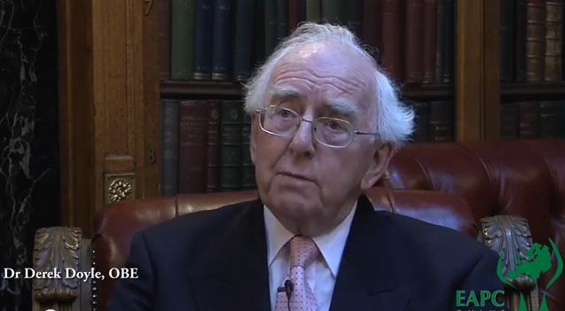
Scottish context: achievements and assets
History of hospice care since 1950
Current mix of specialist services – NHS and charitable
Scottish Partnership from 1991
Academic chairs and some research
Undergraduate and postgraduate training
Living and Dying Well
Strategic Framework for Action (2015) – commitment to ‘health care quality improvement’ approach

Slide 9
Broader challenges
How we die has become a ‘contested space’
LCP marks end of ‘unconditional positive regard’ from the public
Concerns about future role and capacity of specialist palliative care
Complexity of need, co-morbidity, frailty will challenge whole health care system
What sustainable models exist for palliative and end of life care in the future?

Slide 10
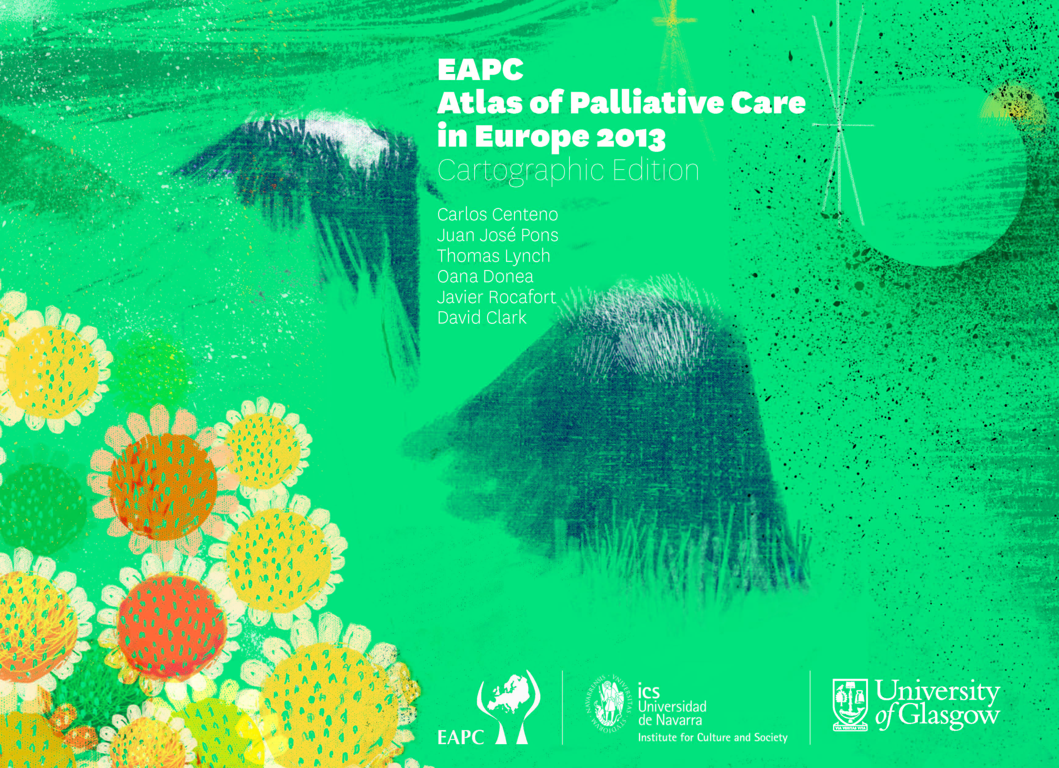

Slide 11
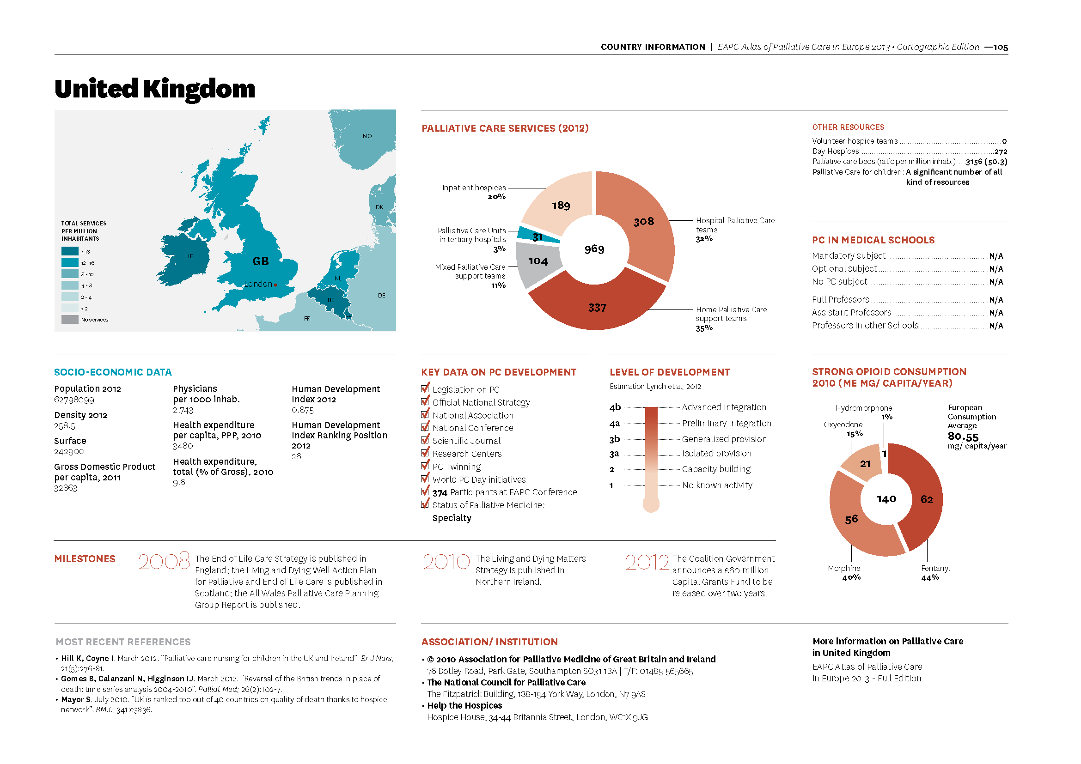

Slide 12
Scottish context: some gaps
No ‘atlas’ entry
Weak national evidence base – on ‘need’ and on ‘what works’
No national research/intelligence centre
Fragmented academic effort
Cross government engagement with end of life issues currently limited to Assisted Suicide bill
Limited investment in public engagement activity

Slide 13
Scottish context: some opportunities
Socio-political context should be congenial to a Scottish perspective on end of life care
Should include clear international commitment and should celebrate the legacy and history – key figures and leaders
Timely moment for public engagement, building on Absent Friends and related approaches, Reith Lecture …
Consolidate the evidence base, building on recent studies – create a Scottish Centre for End of Life Care Research
Clarify the priorities and key interventions - locus and focus – implement and evaluate
Emphasise the ‘public health’ perspective alongside the ‘health care quality improvement’ model

Slide 14
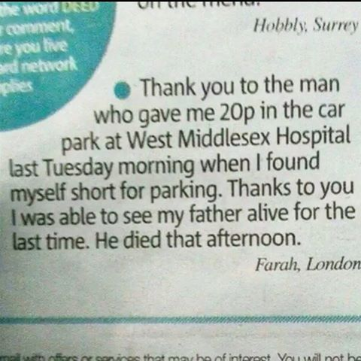
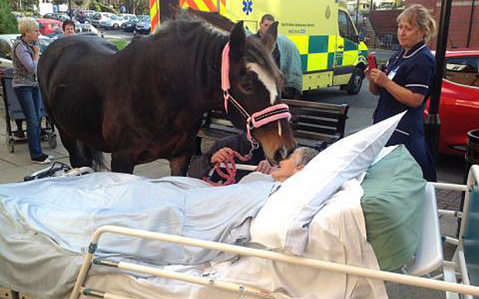
Never underestimate the power of the smallest intervention at the end of life …

