Slide 1




Choices and decisions towards the end of life
Annual Conference 2014
#sppc2014
RCPE-WIFI
Password: chiron1681

Slide 2

Choices and decisions towards the end of life
Annual Conference 2014
#sppc2014
RCPE-WIFI
Password: chiron1681

Slide 3
Hindsight is a wonderful thing (sometimes)
What can we learn from decision science and the demise of the Liverpool Care Pathway
Professor Carl Thompson
Dr Kate Flemming

Slide 4
A guideline exists that seeks to raise the quality of end of life care, have a look at the evidence you have been given, would you want your closest relative to receive care based on the guideline?
Yes
No

Slide 5
thesis...
The Liverpool Care Pathway and others went away… leaving a vacuum… what we know about how humans make judgements and decisions suggests this is a bad thing … other, similar, guidelines have emerged and this is a good thing… if we are to avoid failure in the future then “implementation” needs to draw on decision science and theory.

Slide 6
Opiate pain killers and tranquillisers were being used inappropriately as soon as the LCP was initiated…. morphine as the ‘next step’ on the LCP, even if morphine is not the right drug, or pain relief is not what is needed.
Vague, snatched conversations, in which relatives and carers felt pressurised to give an opinion, the implications which were not made clear to them
Distress experienced could have been mitigated by better communication
Patients, relatives and carers are always entitled to explanations of how decisions have been made and a chance to understand them, but all too often they have not been afforded that opportunity
The decision to withdraw or not to start a life-prolonging treatment should be taken in the cool light of day by the senior responsible clinician in consultation with the healthcare team
Given the difficulty of diagnosing when a patient is actually going to die…Doctors and nurses must communicate with patients and relatives far more honestly about these clinical uncertainties.
Notes:
The Neuberger review into liverpool care pathway… suggests problems.
these sorts of phrases get decision scientist’s radar’s twitching… [click]

Slide 7
Mental
Blueprints?
Time
Prediction
Visibility
Communication
Environment
Hindsight
Group biases
Uncertainty
Notes:
When a decision scientist sees the neuberger evidence what they see is the presence of some fairly central concepts from decision science… etc. etc.
These concepts (to us at least) represent both a threat to higher quality judgement and decision making in end of life care but also potentially a key means of improving judgement and decision making.
One thing that is clear though is that decision making (and associated judgements) are central to determining the quality of end of life care. For example,
How long before this person dies? (judgement)
Palliation or treatment? (judgement)
Initiating pain relief regimen A over regiment B (decision)
Stopping parenteral nutrition (decision)

Slide 8
Decision or judgement?
How long before this person dies? (Judgement)
Initiating pain relief regimen A over regimen B (Decision)
Notes:
Carl – we use the terms Judgement and Decision quite interchangeably through out so thought it was worth spending a couple of minutes clarifying what we are talking about. The first two points on the slide are clear cut in what they are, the second two are less so I would say – but might be a good way of illustration that many situations require elements of both judgement and decision making
Judgement
The ability to make considered decisions or come to sensible conclusions.
Decision
A conclusion or resolution reached after consideration.

Slide 9
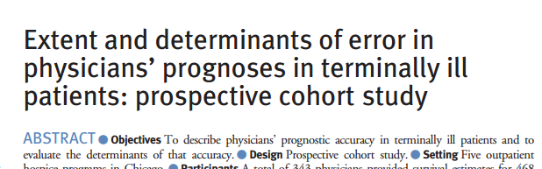
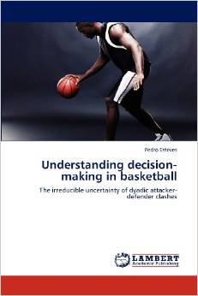
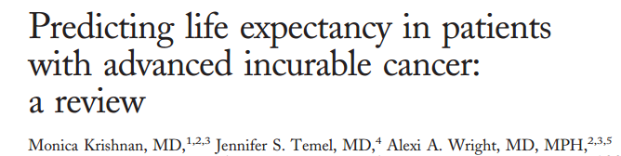
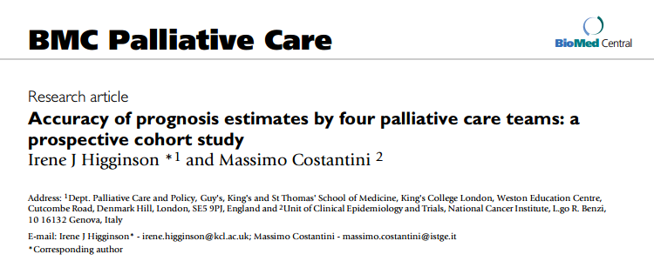
‘Irreducibly uncertain’
Notes:
Knowing we face these kinds of judgements and decisions though and that concepts such as time and how visible our reasoning is or is not does not help us make better decisions. What is required is a framework that explains and provides a basis for improvement. One such framework is offered by the decision scientist Kenneth Hammond. Hammond highlights the central dilemma facing decision makers in healthcare…and politics, economics, the law … or indeed analysts of basketball defence-attack dyads:
the perfect information you need to make a perfectly informed decision will NEVER exist. BUT you still must make these decisions with and for patients and families. Hammond calls this the state being “irreducibly uncertain”.[3]
We will return to hammond’s ideas in a minute…
systematic reviews of the ways in which we deliver that information reveal stubborn uncertainties: a lack of evidence in patients with advanced cancer and palliative stage disease, current practice still not routinely encompassing communication of prognosis, where evidence exists it is often low quality and based on small sample sizes or qualitative designs.[5] The empirical research that might help resolve some of these uncertainties then is largely absent or of questionable value. Whilst many patients are likely to express a preference for honest communication – including prognosis, how they would like that information presented is likely to vary; more uncertainty.[6] The point here is that despite (or even because) of empirical research evidence the field of end of life care is characterised by uncertainty. Not just the generic “irreducible” kind coined by Hammond but also the specific uncertainties that all clinicians in all areas of healthcare are faced with:[7]
How accurate is this test (or my judgement)?
How likely is this intervention to work?
What’s wrong with this patient?
Etc. etc.

Slide 10
Irreducibly uncertain
“What about research, that’ll tell us what to do?”
Surely.........
Notes:
Communication about prognosis of a life limiting disease
Systematic reviews of the ways in which we deliver that information reveal stubborn uncertainties:
a lack of evidence in patients with advanced cancer and palliative stage disease,
current practice still not routinely encompassing communication of prognosis,
where evidence exists it is often low quality and based on small sample sizes or qualitative designs.[5]
The empirical research that might help resolve some of these uncertainties then is largely absent or of questionable value. Whilst many patients are likely to express a preference for honest communication – including prognosis, how they would like that information presented is likely to vary; more uncertainty.[6]
The point here is that despite (or even because) of empirical research evidence the field of end of life care is characterised by uncertainty. Not just the generic “irreducible” kind coined by Hammond but also the specific uncertainties that all clinicians in all areas of healthcare are faced with:[7]
How accurate is this test (or my judgement)?
How likely is this intervention to work?
What’s wrong with this patient?
Etc. etc.

Slide 11

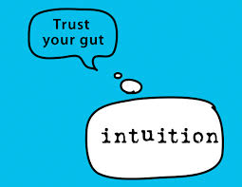

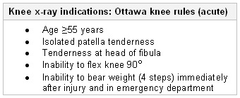

system 1
system 2
Notes:
What do we do when faced with uncertainty in our judgements or our decisions…
Broadly speaking the myriad of potential actions can be captured under three headings:
We use intuition, drawing on what we know and our experience to rapidly reach a conclusion or choice (lets call this system 1 thinking)
At the other end of behaviour we can use algorithms, formal decision rules, protocols and guidelines and follow what they tell us in an entirely rational way (and one that is probably alien and uncomfortable to most people in this room) (lets call this system 2 thinking)
Somewhere in the middle we can use our judgement to mediate research and other formal kinds of information, or indeed we can cross reference our intuition against more formal information sources (like the LCP) or combine the views of colleagues – we behave in a quasi-rational way
[click]

Slide 12

Two systems – Dual Process Theory
System one
System two
234.6x
0.3 ÷
17 =
Notes:
If I asked you what’s the solution to these two problems… the difference between the two modes of thinking become clearer.
System one thinking is rapid, intuitive and implicit or hidden, unconscious, automatic ,non verbal and perceptual and crucially requires low effort of the part of decision makers.
System two is conscious, visible, controlled, slower and requires more effort on the part of judgement and decision makers, linked to language and numbers.
System one and system two are important because how we reason depends on the decision task we are faced with.
So lets return to Kenneth Hammond, his theory of a cognitive continuum and what this tells us about end of life decisions and judgements.

Slide 13
Thinking fast and slow
SHORT | TIME | LONGER
MESSY | STRUCTURE | WELL STRUCTURED
TACIT | VISIBILITY | HIGHLY VISIBLE
LOW | CONTROL | HIGH
SYSTEM ONE
SYSTEM TWO
Clinical reasoning fits task =
better quality judgement and decisions
Notes:
Hammond’s theory says that time, the amount of structure in a decision, how visible the decision process needs to be and the degree of control over how the decision and associated information is presented all shape the degree to
what sort of reasoning is likely to be employed by the decision maker, and - crucially
What sort of reasoning SHOULD be employed by the decision maker
So for example trying to use an algorithm to work out if a patient is sad or satisfied is likely to lead to poor judgements and trying to use intuition rather than formal rules to answer drug calculations is likely to errors and poor judgement.

Slide 14

Valuing what has “utility”

Slide 15
The question… system two option*
P (good death)
μ$
yes
μ
Pathway?
P (bad death)
P (good death)
μ
$ see
Bryce Angus and Lowenstein (2004) Quality of Death: Assessing the importance placed in end of life treatment in the ICU. Medical Care. 42, 423-431
No
μ
P (bad death)
*meanwhile, back in the real world…
Notes:
Going back to our question: a system two approach would have been to combine systematically the probability of a good death with the value we attach to having a good death (something which has been done… by Bryce and colleagues in 2004). Bryce Angus and Lowenstein (2004) Quality of Death: Assessing the importance placed in end of life treatment in the ICU. Medical Care. 42, 423-431
Of course this is not what you did… why not? Well, you did not have much time available, the information we gave you was only partial, you were not asked to justify your choice and you had no ability to shape the decision… all factors that Hammond’s theory tells us are likely to lead to intuitive reasoning. However, what if… you could have increased the time available for your decision making, had to justify your reasoning, were confronted with a patient’s views and preferences and you could control when and how you received the information. Would you still have relied on an intuitive reasoning strategy? In this case you would likely make a better quality decision if you eschewed intuition in favour of a more systematic approach…
Certainly, neuberger suggests that “time” and “visibility of judgement” are often not afforded the weight in the process of making judgements and decisions that they should be…

Slide 16
“The review heard of very vague, snatched conversations, in which relatives and carers felt pressurised to give an opinion, the implications which were not made
clear to them.” p8
Patients, relatives and carers are always entitled to explanations of how decisions have been made and a chance to understand them, but all too often they have not been afforded that opportunity p7
Notes:
Factors such as limited time (whether real or socially engineered) and limited visibility of the basis for clinical decisions and judgements were all highlighted by neurberger… hammonds cognitive continuum theory suggests that intuitive (system 1) thinking will be the result…

Slide 17
Heuristics = cognitive “shortcut”
Usually work well BUT also associated with systematic errors and bias
Notes:
These shortcuts are usually great but they also lead to systematic (i.e. predictable errors… Denmark elephant)

Slide 18
Common shortcuts (and some tips)
Anchoring
Adjustment
Representativeness
Affect
Notes:
So lets just look at four of the more common heuristics likely to impact on end of life care.

Slide 19
Anchoring and framing
  Work outwards from an initial anchor and adjust thinking accordingly
  Is pervasive, subtle, and difficult to overcome.
  eg you more likely to buy meat that is 85% lean rather than 15% fat?
Adjustment
  Caution with qualitative expressions
Notes:
We split you into two groups A and B and you actually had the same choice but presented differently. Group A’s choice was expressed in terms of the benefits of treatment and Group B’s choice emphasised the downside – although the ingredients for the actual choice were exactly the same . In theory (hopefully!) group A were more likely to favour the pathway. Why? Humans generally react to choices differently depending on whether the choice is presented as a loss or as a gain (e.g. lives lost or saved, disease patients treated and not treated). People avoid risks when a positive frame is used (lives saved) but tend towards seeking risks when a negative frame (death not as you would have wished) is used.
framing decisions is a component of a wider set of heuristics we can think of as being about ANCHORING AND ADJUSTMENT – in short, people tend to work outwards from an initial ANCHOR and adjust their thinking accordingly. So when a patient or family asks “which is better intervention A or B?”, first impressions matter.
It is also worth thinking of the power of “how” the risks and benefits are presented (the format) when anchoring your decisions or presenting decisions to others. In a study of forensic mental health professionals tasked with recommending the discharge of “Mr Jones” one group was told that twenty out of every hundred patients are estimated to commit violence against others. The other group was told that patients similar to Mr Jones are estimated as having a 20% chance of committing violence against others. Double the number of professionals faced with the relative risks as a fraction recommended that he NOT be discharged (40% vs. 20%). So frequency formats encourage clarity and images we can relate to whereas percentages are more difficult to conceptualise
We are more likely to buy meat when it is presented as 85% lean rather than 15% fat.
One strategy often used by healthcare professionals to avoid quantitative anchors altogether when faced with uncertainty is to fall back on qualitative expressions of risks and benefits: phrases such as “rare”, “unlikely”, “commonly”.

Slide 20
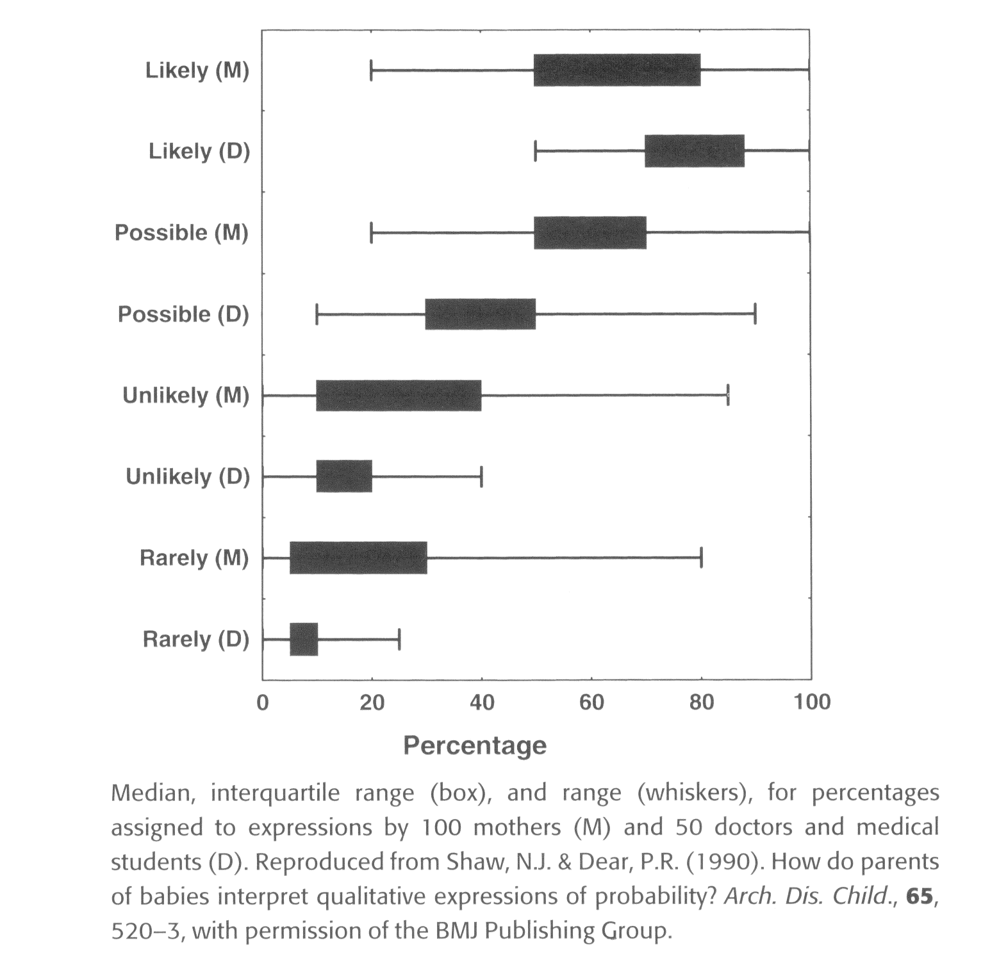
Notes:
This is from a study in which Doctors (D) (and some nurses) gave information to parents (M) and shows the average (median) understanding of risk, and the range within which 50% of values lie (the interquartile range or “middle fifty”).
The message being that qualitative communication of uncertainty often makes uncertainty worse or does little to reduce it with any reliability…

Slide 21
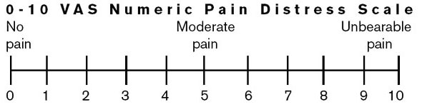
Combatting anchoring
Format (whole numbers not %)
Draw attention to it
Apply same anchor to all decision options
Check qualitative expressions of risk and benefit
Notes:
if you want to foster understanding don’t use percentages when talking to families.
when presenting the pros and cons of various interventions, you first talk about the risks, then it is more likely that families subsequent thinking will be dominated by concerns about risk than if the conversation had started out with possible treatment benefits. Anchoring to concerns, facts or perspectives expressed by those in authority is pervasive, subtle, and difficult to overcome.
One way combating anchoring is to draw attention to it and then offer an alternative perspective.
So a corrective conversation with a family about the use of opiates in which the risks of addiction or being to sleepy look like they are dominating might look like, “I’m noticing that we are talking a lot about the bad things that could happen if we choose morphine, and while this is important, why don’t we try to focus just on the various good things that might happen and see how using morphine or an alternative compares.”
The second point to combat anchoring is to make sure that the same anchoring bias is applied to all intervention options. In other words, do not tolerate yourself or someone else presenting intervention A first in terms of benefits and then risks, and then presenting treatment B first in terms of risks and then benefits. Instead, be fair and present both in the same way, devoting equal time and attention to each.
Check qualitative expressions – maybe use visual methods you can both share… clinicians are used to this for pain… what about for checking wider understanding?

Slide 22


Representativeness: beware “blueprints”
Matthew?
Wayne?
Wayne?
Matthew?
Notes:
Anchoring is a relatively easy heuristic for us as individuals to combat… some shortcuts we us are difficult to even recognise when we are using them…
Luke Birmingham, a forensic psychiatrist at the University of Southampton, showed how something as simple as a name can alter how people are judged. 464 British psychiatrists were asked for a diagnosis based on a one-page description of a 24-year-old who had assaulted a train conductor. When they were asked to assess "Matthew", more than three-quarters gave him a sympathetic hearing, proposing that he was suffering from schizophrenia and was in need of medical help. When recast as "Wayne", he was twice as likely as Matthew to be diagnosed as a malingerer, a drug abuser, or suffering from a personality disorder (all more punitive labels).
When we consider judgements and decisions in any aspect of life we work with “mental blueprints” or depictions of the context/problem/challenge – we all have a tendency to ask, “how does what I am faced with compare to my blueprint of/for this situation” – this is the representativeness heuristic. End of life care is no exception. Our blueprints are context bound: due in part to our temperament, personal experiences, social circumstances, and our cultural heritage. So different partners in a problem may hold quite different blueprints: for example, what a doctor may consider a “good death” (beyond the core beliefs of everyone… pain free etc.) may be different to a family with strong religious convictions. Without communication how would we know?

Slide 23
Antidotes…
Are you leaning on an irrelevant cue?
Strip away evocative language
Beware “wrappers”
Consider the opposite – feel differently?
Remove yourself
Too simple…? how do you know… how often do you stop and check?
Eyes wide open: how to make smart decisions in a confusing world. Noreena Hertz. Harper Collins, London 2013
Notes:
Ways of combating the undesirable effects of these heuristics as professionals (we don’t have time to go into the why for each of these…but trust us) include:
Ask yourself if you could be leaning towards or against a decision because of an irrelevant cue (colour, smell… (great for house buying! Not so relevant for end of life) but sound might be… accents, names:
Beware the influence of “wrappers”. What if the claim wasn’t made in scientific language… how many people were persuaded to buy loreal protect anti ageing serum on the basis of hydrospheres ? Or you didn’t know the social background of the patient? Would you still be making the same decision?
Look out for anchors? Easiest way is to consider the opposite option to the one you prefer? Do you feel differently to your initial decision?
Play with form: turn ratios into perecntages, qualitative descriptions of benefits into numbers… do you feel any different?
Remove yourself from the environment – lose some of the cues and environmental influences. Their impact gets weaker…. So, the environment we operate in can influence these blueprints….[click]
Of course, all these may seem almost too simple – but how many of these do you ever truly use as strategies?
Eyes wide open: how to make smart decisions in a confusing world. Noreena Hertz. Harper Collins, London 2013

Slide 24
Affect
“Hot” and “cold”
Instability of preferences
Empathy “gaps”
Notes:
Our environment is one that is characterised by: touch, feelings, emotions. There is another heuristic that you need to be aware of – that of the shortcuts and biases that arise because of AFFECT.
Affect doesn’t just mean emotions such as anger or fear but also “states” such as hunger (drive state) or pain, discomfort, nausea (motivational states) or even drug and alcohol craving.
When people are in a HOT state (hungry, in pain, angry etc.) they make different choices to when they are in a “cold” state (calm, pain free, not rushed).
The prospect of someone suffering or dying generates images that can be disturbing and unpleasant. Consequently, many people develop an aversion to contemplating the possibility of suffering, death or even certain interventions that seek to minimize suffering but not prevent death. People often use these aversions associated with the disturbing images as a guide or shortcut to figure out the best course of action. Usually they pick the course of action that minimizes the negative images and feelings.
An example is the wife who when calm and in a cold state helps her husband develop a DNA CPR who 2 months later as her husband arrests calls the ambulance to tell them to hurry as her husband is having a heart attack. By preparing her for the reality of an arrest and the options that she has available for support at the time and how she will likely feel she may behvae differently.
Lowenstein [11] goes further and highlights what he calls “hot cold empathy” and the “gaps” that can result. When clinicians are in “hot” states: angry, tired, stressed, hungry… the tendency is for them to believe that they are acting more dispassionately than they actually are. (think about the grumpy referall letter reply or email that has been slept on). When they are in “cold” states: calm, dispassionate, not stressed, then the tendency is for people to underestimate their feelings and behaviours when placed in the “hot” state. Why does this matter…
Cochinov (1999) conducted a study with 168 patients with cancer receiving end of life care. They rated themselves twice a day for pain, nausea, drowsiness etc, but crucially also “will to live”. In a 12 hour period this fluctuated wildly – by 30% or more and correlated with other negative feelings. Patients based their assessment of will to live on their immediate feelings (not the average, borne of reflection, over the 12 hours). Why does this matter? Well important decisions made with patients (or relatives) will likely vary according to when they are made and how they are feeling. One way round this is to allow a period of time for deliberation so that patients and families can experience a range of affective states before significant decisions
As well as gaps within individuals between hot and cold states, gaps also exist between individuals. Indeed, affective gaps may well explain some stubborn patterns in end of life care. Clinicians (in a cold state) must treat patients in pain (in a hot state). The theory suggests that they will underappreciate their pain and thus under medicate. Inadequate pain control in end of life care is a long standing feature of unaided clinical decision making.
These kinds of intra and interpersonal empathy gaps due to affect raise lots of issues about the ability of clinicians (and patients) to predict their preferences (Druley in 1993 found that neither greater professional experience, nor longer relationship with a patient improved accuracy of Drs predictions of patient preferences) and so call into question the validity of living will and advance directives – these are fundamental challenges.
There is no quick fix for working with the affective heuristic. Perhaps the best we can hope for is to recognise the influence that emotion has on individuals and groups when solving problems and decision making.

Slide 25
Guidelines/pathways can help
Smoothing variance
Force reflection
Encourage visibility
Right information not just remembered or noticed
Need evidence and theory based implementation & evaluation (Grol et al. 2005)
Notes:
So do pathways and guidelines help combat these tendencies?
We believe they do. The variations in practice that existed prior to the LCP (i.e. in the absence of decision support) we think were reduced by the pathway (or would have been if it had been implemented properly). A decision rule (which is what pathways offer) does many things but some of the most pertinent for this discussion include:
“Smoothing” the excesses of professional variations in judgements by nudging people towards a consensus behaviour (of course this does not protect against the dangers of “consensus” – see the fallacy of “argument to moderation”: Dr X says we should use opiates, Dr Y says we shouldn’t and so they reach the consensus that just half of the dose will be given!)
Can “force” reflection on a decision about to be taken
Can encourage greater visibility in the rationale for why you favour one option over another
Can bring the information required to a decision that might be overlooked or ignored due to mental representations of the problem space or affective heuristics – importantly this might be research evidence on the probability of various outcomes
There is an important omission in our paper today. Its important because lots of decisions in the multi disciplinary context of end of life care happen in teams. We haven’t covered the heuristics and biases that affect groups. For those that are interested Carl Thompson and Russell Mannion have a paper in press in the international journal of quality in healthcare dealing with group biases.
So it would be tempting at this point to reach the conclusion that the LCP was a good thing that was killed off; we had a bit of a hiatus in which the uncertainties it was meant to address were allowed to resurface; but now new improved versions are here and all will be good. Well, breathing a sigh of relief might be premature.
A note on failed implementation and judgement and decision behaviour
Two things struck us from the Neuberger review of the LCP: i) people said they “used” the pathway, and ii) the evidence presented suggests that they didn’t use it as intended. Why? “Failed” implementation is too vague a reason. We mentioned mindliens and guideline implementation earlier given the reliance on system 1 and short term memory it is unlikely that these recalled guidelines will reflect the complexity of the pathway. Moreover, we are all routinely overconfident in the “correctness” of our knowledge as well as have a tendency to seek confirmatory evidence for our actions rather than things that challenge our views (if you have ever asked a partner or friend to read a university essay as opposed to someone who is more likely to be dispassionately critical… then you have sought confirmatory evidence…).
When the LCP was removed, the behaviours and judgements and guided decision options did not die with it. However, the behaviours, judgements and decisions that emerged in its wake have also become the new norm. Any implementation of a new set of guidance needs to recognise this. Individual and group norms are an important determinant of whether someone is likely to use a technology such as a guideline [14]. To ignore the norms that have settled in in care would be a recipe for sub optimal implementation of any new guidelines and risk the same flaws laid at the door of the LCP by Neuberger.

Slide 26
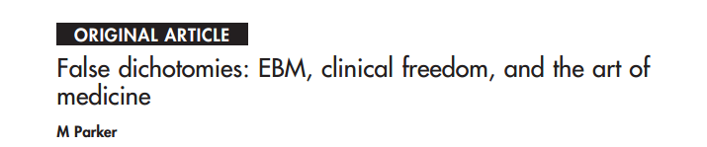
Med Humanities 2005;31:23-30
“All cases are unique, and very similar to others. You will change your mind, but you are not free. Your moment of freedom was yesterday. You made a decision. You set in motion forces in your life and in the lives of others which cannot be reversed.”
T.S. Eliot: The Cocktail Party
Notes:
Sometimes a feeling expressed that pathways and guidelines restrict clinical freedom to make judgements and decisions but there is a paradox that emerges when you know something about the science of decision making:
All patients and judgements are indeed unique and yet similar to others – our choices are not unconstrained. Every day, you make decisions with, for, and on behalf of patients that cannot be reversed… all the LCP did was make those choices visible and perhaps easier to make… the alternative is (perhaps) less visible choices and ones that are more difficult to make. Clinical judgement and decision making does not operate in a vacuum. Guidelines and pathways are no less of a constraint on decision making than the myriad of forces, compulsions, tendencies and unconscious influences that shape our decisions every day. Its heartening that clinicians in end of life care seem to value the contribution of explicitness and truly shared structured communication.
Thank you.

Slide 27
Thank you and questions?

Slide 28
References
Croskerry, P. (2009). Clinical cognition and diagnostic error: applications of a dual process model of reasoning. Adv Health Sci Educ Theory Pract, 14 Suppl 1, 27-35. doi: 10.1007/s10459-009-9182-2
Grol, R., Wensing, M., Eccles, M., & eds. (2005). Improving Patient Care: The Implementation of Change in Clinical Practice.
Hammond, K. R. (1996). Human Judgement and Social Policy: Irreducible Uncertainty, Inevitable Error and Unavoidable Injustice. Oxford: Oxford University Press.
Hammond, K. R., Hamm, R. M., Grassia, J., & Pearson, T. (1987). Direct comparison of the efficacy of intuitive and analytic cognition in expert judgement. IEEE Transactions on Systems, Man and Cybernetics, 17 753-770.
Loewenstein, G. (2005). Hot-cold empathy gaps and medical decision making. Health Psychol, 24(4 Suppl), S49-56. doi: 10.1037/0278-6133.24.4.S49
Royal College of Physicians. (2007). Palliative Care Services: Meeting the needs of patients. London
Violence risk assessment and risk communication: The effects of using actual cases, providing instruction, and employing probability versus frequency formats. Slovic, Paul; Monahan, John; MacGregor, Donald G. Law and Human Behavior, Vol 24(3), Jun 2000, 271-296.

Slide 29
Choices and decisions towards the end of life
Annual Conference 2014
#sppc2014
RCPE-WIFI
Password: chiron1681

