Slide 1
Update on the Assisted Dying for Terminally Ill Adults (Scotland) Bill
SPPC’s approach to this issue
The process by which a Bill may become law
The story so far
Next steps
Notes:
What I’m going to cover
Quite a lot of detail, and rather unavoidably some text – heavy slides. Wil share the slides afterwards. Also a link in final slide to all the detail and more on SPPC website
Devil is in the detail

Slide 2
SPPC’s approach to a change in the law
Assisted dying raises issues of a moral, personal and ethical nature upon which many of SPPC’s member organisations (for example our member NHS Boards) are institutionally unable to hold a position. SPPC therefore does not adopt a position in principle either in support or in opposition to a change in the law.
Instead, SPPC’s approach is:-
• To take a factual and evidential approach rather than a moral or religious one
• To educate and inform about palliative and end of life care and to advocate its importance
• To challenge misinformation about palliative and end of life care
• To acknowledge and give an account of complexities which tend to get lost in polarised debates
• To be honest about the limits of palliative care to relieve all suffering
• To be honest about the current deficiencies in care towards the end of life experienced by some people
• To critically review and present a view on the specific provisions of the proposed Bill such that if the Bill is passed potential harms (to vulnerable people and the practice and provision of palliative care) are minimised.
Notes:
Context – SPPC’s approach to the issue. MSPs sometimes assume because we are a palliative care organisation that we are opposed in principle,

Slide 3
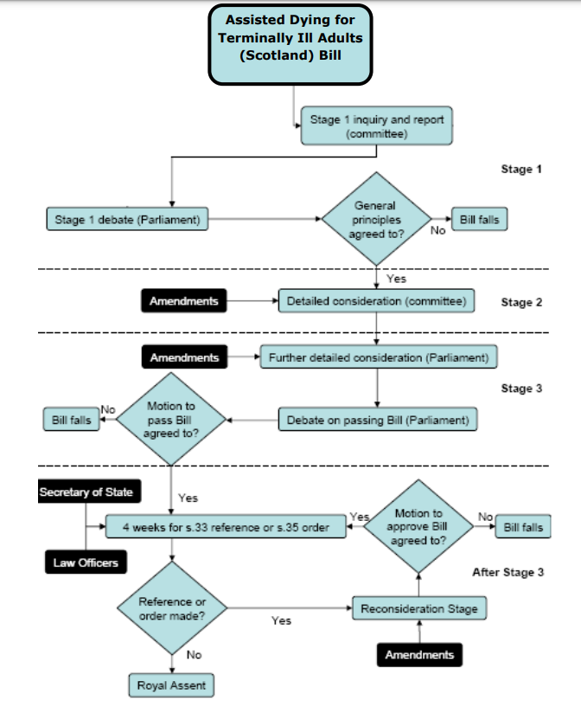
How a Bill becomes an Act (law)
Notes:
Don’t worry about the detail.
At Stage 3 – it looks like the middle of the process but we’re approaching the finishing straight.

Slide 4
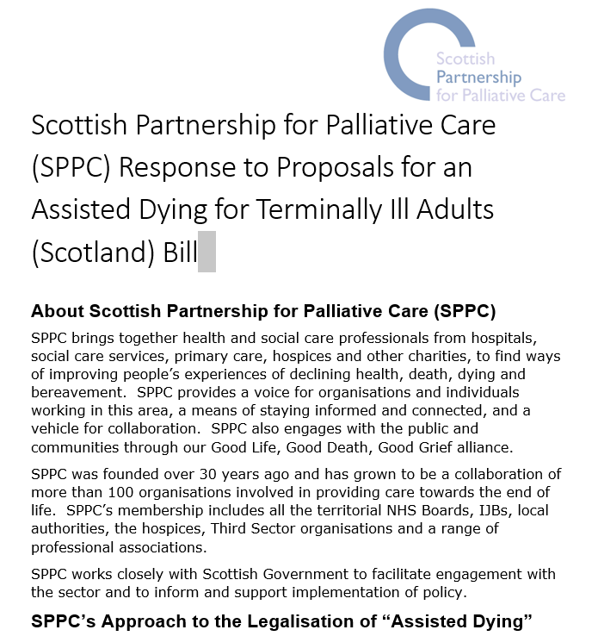
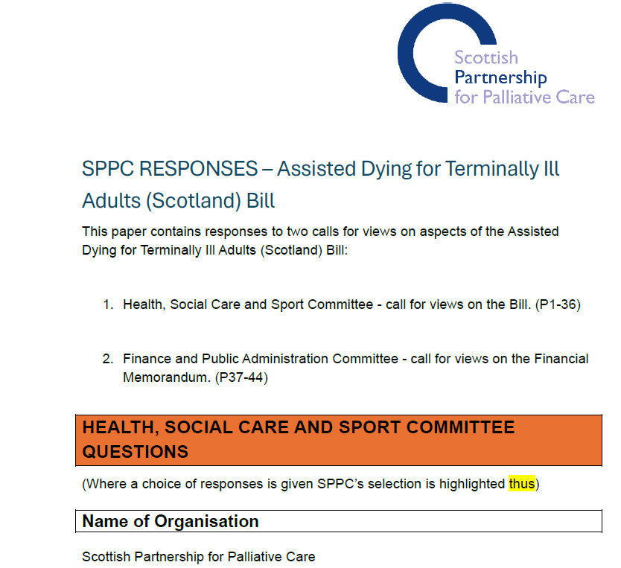
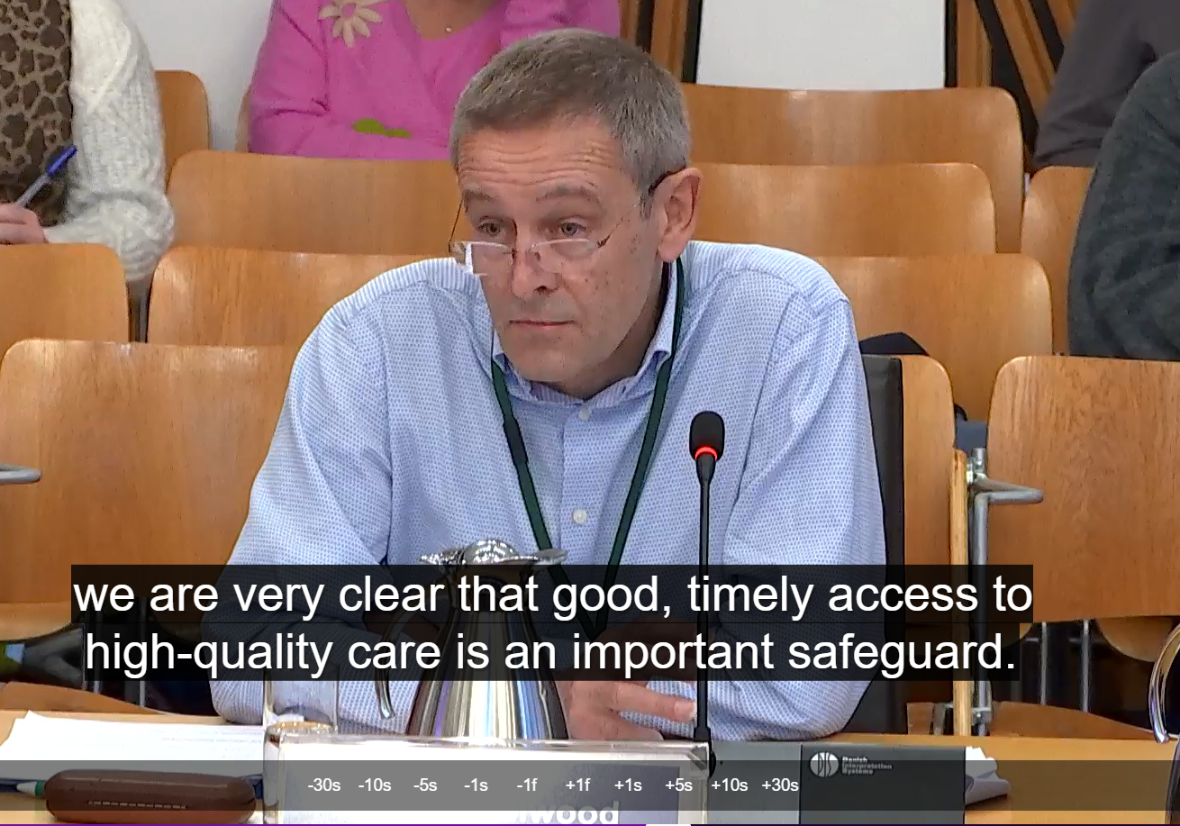
MSP proposes a new law (but not the detail) 2021
Consultation on the proposal
Support of at least 18 MSPs from different parties
Bill drafted
Bill published (March 2024)
Bill passes Stage 1 vote (May 2025
STAGE 2 Amendments debated in Committee
REVISED BILL PUBLISHED
The story so far
SPPC Evidence and Participation at Each Stage
Notes:
Process started in 2021. Consultation on proposal to have a law.
Most of the time spent drafting the Bill which was only published in March 2024.
The consultation on the Billl, evidence sessions at committee, vote of whole parliament to move to Stage 2.
Amendments debated and voted on by HSCSC. Finished at end of November.
Revised Bill published. Again links in final slide.

Slide 5
SPPC Efforts to Amend the Bill at Stage 2
SPPC worked with Bob Doris MSP to submit over 40 amendments to the Bill. Marie Curie, CHAS, Hospice UK and RCN (amongst others) all worked to secure important changes to the Bill.
Changes Proposed by SPPC/Bob Doris MSP and Agreed by the Committee
Reasons for Seeking an Assisted Death
The Coordinating Medical Practitioner (CMP) must as part of the assessment process “enquire about and discuss the person’s reasons for wishing to be lawfully provided with assistance to end their own life”. Strangely the Committee also voted against SPPC amendments requiring the reasons to be documented in the Statements which conclude the AD assessment (and sanction AD).
Social Work Assessment
The CMP must inform the person seeking AD that they can ask to be referred for a social work assessment, and inform them of the potential benefits of such an assessment.
Reducing the discretionary nature of referral for specialist opinion during assessment for AD
Where the CMP has any doubt about the capacity of a person seeking AD they MUST refer the person to a specialist. (previously the Bill said “MAY refer”).
Where the CMP has any doubt about whether the person seeking AD is “terminally ill” they MUST refer the person to a specialist. (previously the Bill said “MAY refer”).
Notes:
Look at what was changed by amendments. A slightly SPPC centred account. Lots of organisations supported the development and proposal of different amendments. Colleagues at HUK, Marie Curie – hope they will comment in discussion. Also important amendments from RCN and Scottish Association for Social Work. Undoubtedly others, but there is know easy way to know what went on in the background and who enabled each amendment.
If I mention an amendment later on which you were involved in supporting do shout out and take a bow.
Standby for the detail:
SPPC worked with Bob Doris MSP to submit over 40 amendments to the Bill.
Acknowledge the time and effort put in by Bob to help develop the amendments and then present them across several meetings of the HSCSC.

Slide 6
SPPC Efforts to Amend the Bill at Stage 2
Changes Proposed by SPPC/Bob Doris MSP and Rejected by the Committee
Definition of terminal illness
SPPC amendments to insert a 6-month prognosis into the definition were rejected.
Coercion
SPPC amendments to insert a definition of coercion into the Bill covering undue pressure or influence from: “the person’s own beliefs about themselves; any other person; the expectations of society; the health and social care system; the state.” were rejected.
Mandatory Referral to Specialist Palliative Care
Amendments to require anyone seeking AD to be referred for a specialist palliative care assessment were rejected. However, an amendment by Jackie Baillie MSP requiring the CMP to inform the person seeking AD that “that they can be referred for a palliative care assessment to explore whether any additional support could be provided to them” was agreed.
Reducing the discretion of the CMP in terms of what may be explained, discussed and advised during assessment
An amendment was rejected which would have required the CMP to explain and discuss the following (the Bill currently allows the CMP to explain and discuss these topics “in so far as the CMP considers appropriate”: the person’s diagnosis and prognosis; any treatment available and likely impact of it on the person’s terminal illness; any palliative or other care available; the nature of the substance that might be provided to assist the person to end their own life (including how it will bring about death).
A similar amendment would have required, without qualification, the CMP to advise the person to: inform their GP they are seeking AD; discuss the request with those close to the person.
Vulnerable Adults
SPPC amendments which would have required the CMP, as part of the assessment, to ask the relevant local authority whether they held any information which might indicate whether a person might have a preexisting vulnerability was rejected. Related amendments which would have mandated a referral for social work assessment if vulnerability was identified or suspected was rejected.
Notes:
Personal observations on the committee process:
A lot of apparently “block voting” against amendments to the Bill, consistently 8-2 or 7-3.
This changed a bit towards later meetings of the committee. It seemed like personal dynamics made a bit of a difference.
Scottish Government didn’t propose any amendments at Stage 2 stating that it wished to maintain a position of neutrality (perhaps reflecting media reports that the Cabinet is split on the issue).
SG did publish a commentary relating to “technical, legal and deliverability implications” on all the amendments “to support informed parliamentary debate”.
Parts of the commentary on the amendments were frequently quoted by Liam McArthur MSP when speaking against amendments.
Since SG has provided no similar commentary on the actual provisions in the Bill the situation to me appeared very unbalanced.

Slide 7
SPPC Efforts to Amend the Bill at Stage 2
Changes Proposed by SPPC/Bob Doris MSP and Rejected by the Committee (continued)
CMP Assessment Report
SPPC amendments requiring the CMP to produce a report detailing:
The reasons the person gave for seeking AD
What evidence was gathered and used to inform the decision
The reasons the practitioner reached their judgement
were rejected.
Protracted Dying
SPPC amendments to require SG to make regulations about handling cases where death does not follow the taking of the lethal substance within a reasonable time frame were rejected.
Administration and regulation of assisted dying services
SPPC amendments requiring that SG produce regulations about the regulation and oversight of persons who carry out AD under the act, to ensure the safety and wellbeing of the people provided with AD including: regulation of settings where AD may or may not take place; the role of HIS and the Care Inspectorate in regulation and scrutiny; and a process to raise concerns about the provision of AD to a person were all rejected.

Slide 8
How was the Bill amended at Stage 2?
Definition of terminal illness
Clause added that a person is not terminally ill only because they have a disability or a mental disorder.
Clause added to define mental disorder (by reference to Mental Health Act (2003)
Eligibility
Minimum age raised from 16 to 18 years (and this is reflected in a change to the forms documenting eligibility).
Training for co-ordinating registered medical practitioners (CRMP) and independent registered medical practitioners (IRMP)
(there are 2 doctors involved the lead one (CRMP) and independent one (IRMP) who essentially repeats the assessment after the CRMP). RMPs used here sometimes to indicate both roles).
Language strengthened so that SG MUST specify by regulations the training required for these roles.
Duty to direct
A new section with a couple of clauses requires that where a medical practitioner is approached by someone seeking AD, but the practitioner is unable or unwilling act as the CMP they must either:
  Direct the person to another doctor who may be willing to be the CMP or/
  Direct the person to information about AD in Scotland

Slide 9
How was the Bill amended at Stage 2?
Medical practitioners’ assessments
A clause added such that the assessments must include ascertaining where the person seeking AD has been provided with, or offered, appropriate social care relevant to the terminal illness
RMPs must make enquiries of professionals currently or recently providing health/social care to the person requesting AD (in so far as the RMP considers appropriate)
RMPs must consider making enquiries of health, social care or social work professional with qualifications or experience of something relevant to the person being assessed
Broadening of the things the RMP must explain and discuss (alongside palliative care) to include hospice or other care, including symptom management and psychological support.
RMPs must “enquire about and discuss the person’s reasons for wishing to be lawfully provided with assistance to end their own life”.
RMPs must inform the person seeking AD that they may be referred for a social work assessment (and explain any potential benefits of such an assessment). But there is a strange cross reference to “subsection (4)(a)” which doesn’t seem to exist/make sense
Where the RMP has any doubt about the capacity of a person seeking AD they MUST refer the person to a specialist. (previously the Bill said “MAY refer”).
Where the RMP has any doubt about whether the person seeking AD is “terminally ill” they MUST refer the person to a specialist. (previously the Bill said “MAY refer”).
RMPs must inform the person that they can be referred for a palliative care assessment to explore whether any additional support could be provided to them
Signing by a proxy
Instead of only advocates, solicitors and JPs being able to act as a proxy, the Bill now allows any adult who has known the person for 2 years, or who meets a description (to be specified in SG regulations).

Slide 10
How was the Bill amended at Stage 2?
Right to advocacy
A whole new section (14) granting a legal right of access to independent advocacy services to anyone considering requesting AD who “requires an advocate’s help to effectively and safely request that assistance and with the process leading up to provision of that assistance”.
A subsection requires SG to set standards for such independent advocacy services
Provision of assistance (to shorten life)
A clause requiring that the lethal meds must be provided to the RMP (or an authorized healthcare professional they have delegated to) by a registered pharmacist
A nurse has to be accompanied by a doctor when providing the lethal meds (previously it could have been a lone nurse)
A doctor has to confirm immediately prior to providing the lethal meds that the person has capacity and is acting voluntarily without coercion (previously this may have been left to a nurse)
A clause stating that “for the avoidance of doubt, nothing in this section authorises any person to administer an approved substance to the adult on their behalf with the intention of bringing about the adult’s death”.
A clause setting out the sorts of assistance which the CMP may provide: preparing the substance for use; preparing a medical device which can be used to self-administer; help the person to ingest or otherwise use the substance. A subsequent clause saying that none of this assistance must prevent the final decision and act of using the lethal substance being taken by the person. And a clause saying that a nurse must be accompanied by another health professional if providing this assistance.
A clause allowing the RMP (or authorized health professional) not stay in the same room as the person once they have used the substance (but they must “remain with the adult”, presumably nearby, until they have died).
A clause requiring that CRMP must record and report to PHS any complications, adverse reactions, or unintended consequences arising from the lethal meds.
A clause requiring SG to produce regulations on the training, qualifications and experience required of the “authorized health profession” to whom the CRMP may delegate aspects of the provision of assistance.
A clause requiring SG to consult before producing these regulations (and also regulations specifying the “approved substance”).

Slide 11
How was the Bill amended at Stage 2?
Conscientious objection
The amendments here are a bit confusing (and possibly not internally consistent).
The first clause in this section has been changed as follows “An individual is not under any duty (whether arising from any statutory or other legal requirement) to participate directly in anything authorised by this Act to which that individual has a conscientious objection “. So no need to justify non-participation by virtue of belief/conscience.
However, there are then 3 subsequent amendments which essentially require that a person not participating must not be subject to any detriment by virtue of their not participating. Two of these non-detriment clauses make reference to non-participation due to conscience. This looks like it will need to be clarified at Stage 3, probably by deleting all clauses with reference to conscience.(?)

Slide 12
How was the Bill amended at Stage 2?
No duty to raise assisted dying
A new clause stating that no medical practitioner is under any duty to raise the subject of AD with a person
A new clause stating that nothing in the previous clause prevents a medical practitioner raising the subject if they judge it to be “appropriate” to discuss it with a person (but see below for people aged under 18)
Health professionals must not raise the subject of AD with a person under 18 unless it has first been raised by the person themselves (either with that professional or another one previously).
Provision of AD must not be part of an anticipatory care plan (sic) for anyone under 18.
Provision of assistance outwith the NHS
A new section:
SG must consult and then develop regulations about the provision of AD outside the NHS including
  The role of HIS and Care Inspectorate
  Any settings or services where AD must not be provided
Offences
A new offence of coercing or pressuring a person into using a lethal substance (previously the only offence was coercing a person to make a first or second Declaration of intent to pursue AD)
A new offence of advertising AD (to promote, encourage or solicit the provision of AD to a person) punishable by a fine or max 2-year imprisonment. An associated clause seeks to ensure the advertising ban doesn’t impinge on the provision of information for professionals or the public.

Slide 13
How was the Bill amended at Stage 2?
Assessment of likely impact of Act on palliative and end of life care services
A new section:
As soon as the Bill becomes law SG must carry out an assessment of, and publish a report on, the likely impact of the law on hospices and providers of palliative care services including effects on:
  Staffing, including training and support required
  Operation of existing services
  Existing funding streams
  Regulation and scrutiny of palliative and end of life care
Code of practice on interaction with palliative and end of life care services
Another new section.
After publishing the impact assessment report mentioned above SG must consult and prepare a code of practice on the interaction between provision of AD and the support provided by hospices and providers of palliative and end of life care. The code of practice must cover:
  Guidance, training and support to health and social care professionals providing hospice, palliative and end of life care (including staff of non-statutory providers)
  Any measures to impact any adverse impacts on existing palliative and end of life care services
  How existing and future statutory funding streams intended to support palliative care services can be differentiated to ensure that AD is not funded at the expense of existing palliative care services
  How provisions in any AD Act interact with existing regulation and scrutiny of palliative care services
Notes:
Shout out to HUK for these amendments, Helen Malo and especially Aileen Morton who led their work on this.

Slide 14
How was the Bill amended at Stage 2?
Guidance
This section lists all the areas of SG Guidance associated with the Bill.
All the guidance listed MUST be developed (previously “may”)
New requirement to produce guidance on training and quality assurance to ensure “the effective implementation of the Act”
For all the guidance listed SG must consult trades unions and professional bodies representing people who may carry out functions under the Act (and anyone else they think appropriate)
A new clause requiring that guidance of the kind mentioned in subsection (2)(g) must be developed with and approved by the Lord Advocate’s office. But that subsection doesn’t exist because the amendment creating it was rejected! It would have been guidance on where the legal and professional accountability lies for AD.
Duty to provide information
A new Section:
SG must ensure information about AD in forms accessible to and understandable by:
  Terminally ill adults wanting AD
  Health and social care professionals
  The general public

Slide 15
Anorak Corner
Regulation-making powers
There are two ways SG can make regulations. The “negative procedure” essentially involves little scrutiny. The “affirmative procedure” enables a bit more scrutiny. The revised Bill requires the following:
Topic of Regulations | Affirmative procedure | Negative Procedure
Training, qualifications and experience of CRMPs, IRMPs and “authorized health professionals” | ✓ (initial regulations only)
Independent advocacy service standards | ✓
Specifying an approved substance | ✓
Information which must be provided to Public Health Scotland for their annual reports on AD | ✓
Incidental minor tweaks to the Act | ✓
Forms of identity which can be used to comply with Act |  | ✓
Description of person who can be a proxy |  | ✓
Tweaks to the scope of data PHS must provide in their reports to ministers |  | ✓
Changes to the “Statements” – the forms used to record the AD process completed by CRMP |  | ✓
Commencement of the Act
A new requirement that the ACT can’t come into effect until arrangements for people to access for independent advocacy are in place

Slide 16
Next Steps – Stages 3 and Finalisation
End of Nov
Now awaiting publication of deadline for amendments
Late Feb/March??
By March 2026
Stage 2 completed
Stage 3 Amendments
Amendments submitted for consideration at Stage 3
Stage 3 Debate
Some procedural stuff – for example getting permission from Westminster for elements which are beyond Holyrood’s powers
Finalisation
Publication of Bill as amended at Stage 2
Any Stage 3 amendments, and the revised Bill goes back to the main chamber for debate, further amendment and a final vote
Royal Assent from King Charles
Notes:
Stage 3
Again all MSPs and SG can lodge amendments
Not clear whether SG will lodge any amendments
Role of presiding Officer selects amendments
Vote on amendments. Then vote on Bill
Timeline
Prospects at Stage 3

Slide 17
How Might SPPC and Others Seek (again) to Amend the Bill?
A tighter / narrower definition of “terminal illness” by adding a 6 month prognosis requirement
A requirement to consider undue indirect pressures (eg feeling a burden, financial difficulties, unavailable care options)
A requirement to document the reasons given for seeking AD
Protecting palliative care budgets and other resources
Require assessing CRMP to seek information held by local authorities about people who may be at risk/vulnerable
Require the CRMP to produce a report on the evidence used to inform the decision and the reasoning supporting the decision made.
Place a duty on SG to produce regulations about what should happen when a person who has taken the lethal substance doesn’t die within a reasonable timeframe.
Add a process by which concerns about an AD or a planned AD may be raised
Suggestions please
Notes:
Can resubmit amendments defeated in Committee
Some areas where might focus.
Guiding focus – safeguards for vulnerable people, protecting and promoting the practice and provision of palliative care

Slide 18
Links to Key Documents
Flow chart of parliamentary process
SPPC’s approach to the issues of “assisted dying”
Evidence submitted by SPPC to the Health Committee
https://www.palliativecarescotland.org.uk/news/news/assisted-dying-bill-published/
Summary of SPPC work at Stage 2 and outcomes of all amendments https://www.palliativecarescotland.org.uk/news/news/assisted-dying-bill---latest-update/
The Bill (oringal version and now as amended)
All the background papers - Policy Memorandum, Financial Memorandum, Delegated Powers Memorandum, Explanatory Notes
Stage 1 Committee Report
Minutes and video of everything that happened at Stage 2
Correspondence with the Committee (including SG positions)
Deadline for Stage 3 amendments, and lists of amendments once they start to be submitted
https://www.parliament.scot/bills-and-laws/bills/assisted-dying-for-terminally-ill-adults-scotland-bill

