Slide 1



Scottish Ambulance Service
Macmillan Palliative & End of Life Care Project
A Partnership Project: Macmillan and Scottish Ambulance Service
Impacting outcomes and experiences at the heart of the system
Programme Lead: Scott Mackinnon
sas.endoflifecare@nhs.scot
Notes:
"Good evening, everyone. Thank you for the opportunity to speak to you today about a project that is making a real difference at the heart of our healthcare system: the Scottish Ambulance Service Macmillan Palliative and End of Life Care Project.“
"My name is Scott Mackinnon, and I’m Programme Lead for Palliative and End of Life Care with SAS and I’m here today with Keri Ficking. You may recall my colleagues presenting at the start of this project in May 2022 and it’s great to present again to share the significant impact this initiative is having on outcomes and experiences for patients and their families across Scotland.“
"Before we begin, I also want to proudly acknowledge that the dedicated team behind this work was recently recognised as the 'Top Team Award' winners at the 2024 Scottish Health Awards – a testament to their commitment and the project's success

Slide 2
Scottish Ambulance Service
The Scottish Context
Increase in population living longer with complex and life limiting conditions
Annual deaths in Scotland projected to rise by 13.% by 2040 with 74%-95% potentially
benefitting from Palliative Care
Significant projected increase in deaths due to cancer (21%) and dementia (185%) by 2040.
  Multimorbidity projected to affect 43.5% of all deaths by 2040 (82% increase from 2017)
sas.endoflifecare@nhs.scot
Notes:
To understand the importance of this project, it's crucial to look at the evolving healthcare landscape in Scotland."
"We have an aging population, with increasing numbers of people living longer lives, often with complex and multiple life-limiting conditions. This demographic shift brings with it a growing demand for palliative and end-of-life care."
"Projections are stark: annual deaths in Scotland are expected to rise by nearly 14% by 2040 compared to 2017 figures. And critically, it's estimated that between three-quarters and 95% of these individuals could benefit from a palliative care approach. We're also seeing significant projected increases in deaths related to cancer – up 21% – and a staggering 185% increase for dementia by 2040. Multimorbidity is also a growing challenge, expected to affect over 43% of all deaths by then – an 82% increase."

Slide 3

Scottish Ambulance Service
The Scottish Context
  SAS clinicians are frequently the first point of contact for PEOLC crises.
  Nearly 20% of SAS emergency calls (approx. 136,811 in 2023) relate to patients with palliative care considerations.
  End-of-life care demand (patients dying within 6 months of a call) accounts for approx. 7% of annual SAS emergency demand.
  The Ambulance Service at the Forefront:
sas.endoflifecare@nhs.scot
Notes:
"The Scottish Ambulance Service is often at the very forefront of this need. Our clinicians are frequently the first point of contact when individuals or their families face a palliative or end-of-life care crisis at home or in their community."
"In 2023 alone, nearly 20% of all our emergency calls – that's over 136,000 incidents – related to patients with palliative care considerations. And when we look at patients who sadly die within six months of contacting us, this accounts for approximately 7% of our annual emergency demand."

Slide 4



Scottish Ambulance Service
The Unmet Need
Ensuring timely, appropriate, compassionate care aligned with patient wishes.
Reducing avoidable hospital admissions.
Addressing gaps: Lack of formal PEOLC education, absence of specific patient pathways, and limited professional-to-professional support for SAS clinicians.
The Challenge:
(Identified Pre-Project)
sas.endoflifecare@nhs.scot
Notes:
"Prior to this project, the challenge was clear: how do we ensure every patient receives timely, appropriate, and compassionate care that truly aligns with their wishes, especially when facing an emergency? How do we reduce potentially distressing and avoidable hospital admissions for those at the end of life? And critically, how do we address the identified gaps in formal palliative care education, specific patient pathways, and professional support for our dedicated SAS clinicians?"

Slide 5
Scottish Ambulance Service
Introducing the SAS Macmillan PEOLC Project
A Strategic Partnership: A vital collaboration between the Scottish Ambulance Service and Macmillan Cancer Support (initially piloted 2019, national team from April 2022 - March 2025 with Macmillan funding).
Shared Vision: To significantly enhance the quality, responsiveness, and person-centredness of care provided by SAS to people in Scotland with palliative and end-of-life needs requiring an urgent ambulance response.
Core Project Objectives
Empower SAS Clinicians
Improve Patient & Carer Experiences & Outcomes
Develop Alternative Care Pathways
Foster System Collaboration
sas.endoflifecare@nhs.scot
Notes:
This has been a vital strategic partnership between SAS and Macmillan Cancer Support. Following an initial pilot in Forth Valley in 2019, a national team was established from April 2022, fully funded by Macmillan until March of this year (2025)." Total committed £970k
"Our shared vision has been ambitious but essential: to significantly enhance the quality, responsiveness, and person-centredness of the care our Service provides to people across Scotland who have palliative and end-of-life care needs and require an urgent ambulance response.“
"To achieve this, we set four core project objectives:
"Firstly, to Empower our SAS Clinicians by improving their knowledge and skills through bespoke education, focusing on crucial areas like symptom control and communication, thereby increasing their confidence and competence.“
"Secondly, to Improve Patient and Carer Experiences and Outcomes, ensuring that the care we deliver is always aligned with 'What Matters to You?' and that we actively work to reduce unnecessary hospital conveyance.“
"Thirdly, to Develop Alternative Care Pathways, working collaboratively with our partners across the health and social care system to implement pathways that genuinely meet individual patient needs and respect their preferred place of care.“
"And finally, to Foster System Collaboration, adopting a whole-system approach so that the significant clinical contribution of SAS clinicians is fully recognised and integrated within the broader provision of palliative care."

Slide 6
Scottish Ambulance Service
Core Pillars of the Project – A Multi-faceted Approach
1. Workforce Education & Development
2. Pathway Redesign & Enhanced Collaboration
3. Improving Patient & Carer Experience
4. Data, Evaluation & Digital Enablement
sas.endoflifecare@nhs.scot
Notes:
"Our approach has been multi-faceted, built on four core pillars.“
"Pillar One: Workforce Education and Development. This has been absolutely fundamental. We've delivered comprehensive, bespoke palliative and end-of-life care training. This includes Continuing Professional Development sessions focusing on symptom control, communication, and the fundamentals of palliative care. We've also integrated this training into our Trainee Technician VQ programme, our Newly Qualified Paramedic programme, and have engaged with Higher Education Institutions and Advanced Practice development."
"The uptake has been fantastic: over 4,466 staff members have received this formal education."
"We've also developed and rolled out seven dedicated palliative and end-of-life care modules on the TURAS learning platform, with around 500 staff completions by December 2024, and we've trained staff to deliver Last Aid courses within SAS, broadening awareness and understanding."
"Pillar Two: Pathway Redesign and Enhanced Collaboration. This is where we've worked to change how care is delivered, a major achievement has been the development and implementation of 29 new alternative pathways to Emergency Department admission right across Scotland. This has been a truly collaborative effort, working with all 14 Health Boards, 31 Health and Social Care Partnerships, 17 adult hospices, 2 children's hospices (CHAS), and numerous third-sector organisations. We've also focused on building stronger professional-to-professional communication links, for instance, enabling direct contact with hospices for decision support or even direct admission where appropriate."
"Pillar Three: Improving Patient and Carer Experience. Everything we do is ultimately for the patient and their loved ones. We've centred our care around the individual's needs, their wishes, and any recorded preferences, such as those in a Key Information Summary or Anticipatory Care Plan. A key part of this is ensuring families and carers are informed, involved in decision-making (where appropriate), and feel supported.
"Pillar Four: Data, Evaluation, and Digital Enablement. To ensure we're making a difference and can continuously improve, we've systematically monitored key metrics. This includes staff confidence levels, the use of Just in Case medications, conveyance decisions – importantly, using linked outcome data via the Unscheduled Care Datamart – and, of course, patient and carer feedback. We're also actively leveraging digital tools like KIS and are contributing to the national strategy around tools like ReSPECT and the National Digital Platform to ensure our clinicians have the information they need at the point of care.“
Ill now hand over to Keri, who will talk through the key achievements in more details before I finish with key learning and future considerations for the team.

Slide 7
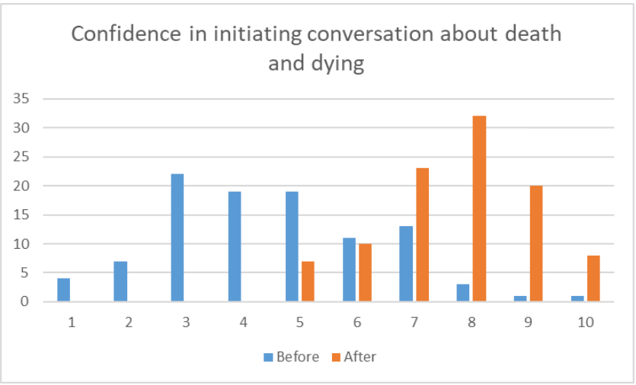
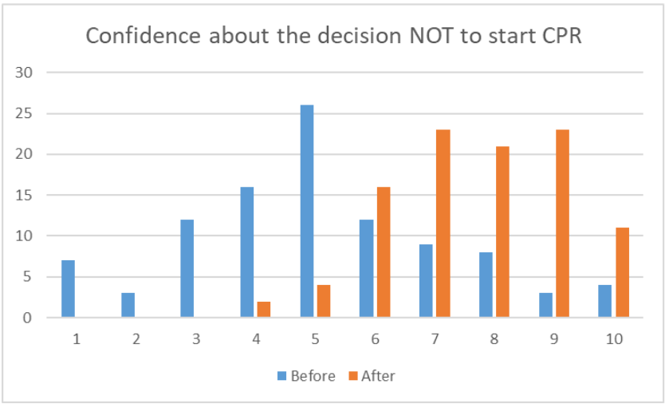
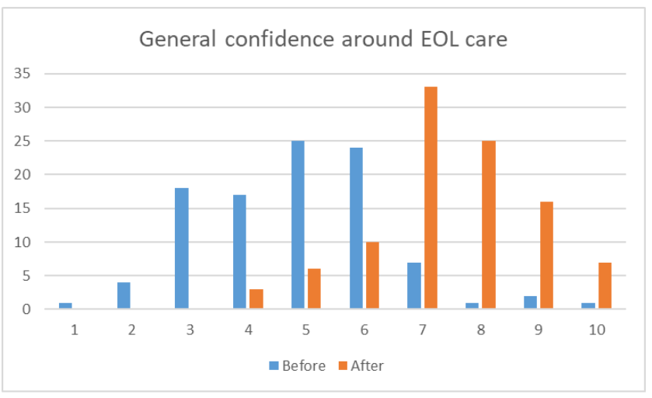
Scottish Ambulance Service
Key Achievement: Empowering Our Staff
sas.endoflifecare@nhs.scot
Notes:
One of the most significant achievements of this project has been the empowerment of our frontline staff.“
"our targeted education programmes have demonstrably transformed the confidence and competence of SAS clinicians. Our data on this is showing how pre-education confidence scores for challenging situations, like initiating conversations about dying or deciding against futile CPR, averaged around 4 or 5 out of 10. Post-education, these scores rose significantly to 7 or 8.“

Slide 8
Scottish Ambulance Service
Improved use of Just in Case medications
sas.endoflifecare@nhs.scot
Notes:
"This increased confidence translates directly into enhanced clinical practice, particularly in the crucial area of symptom control, especially through the better use of 'Just in Case' or JIC medications.
"We've seen a steady and marked increase in the number of JIC administrations by our clinicians, particularly since the national team started in April 2022. The graph clearly shows this, with administrations rising from fewer than 50 in 2019 to over 250 in 2024."
"This means more patients are receiving timely symptom relief. In 2024, up to December, 171 individual patients received JIC medications from our crews, compared to just 56 in 2021. And on average, we're administering more medications per patient where needed – 1.6 now, versus 1.3 previously.“
Increase in the % of patients able to remain at home following JIC administration 82% in 2024 Vs 32% in 2019

Slide 9
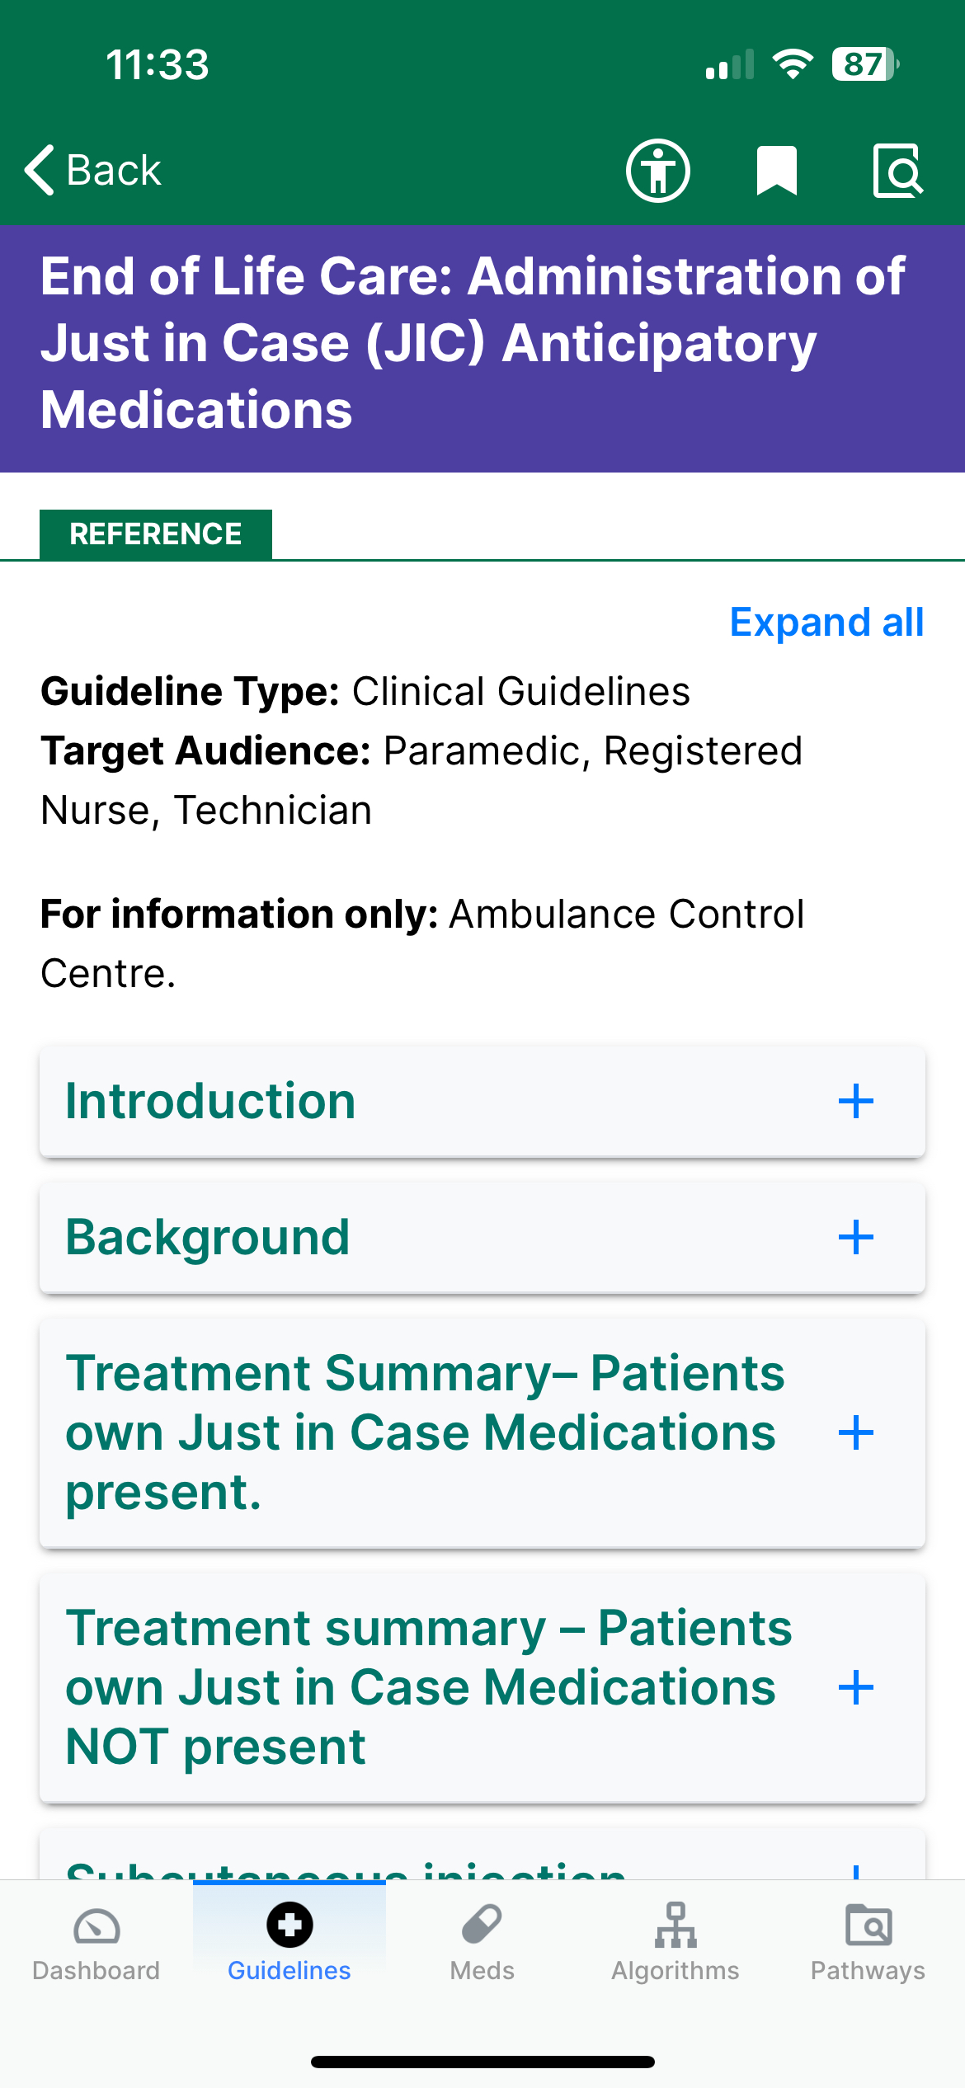
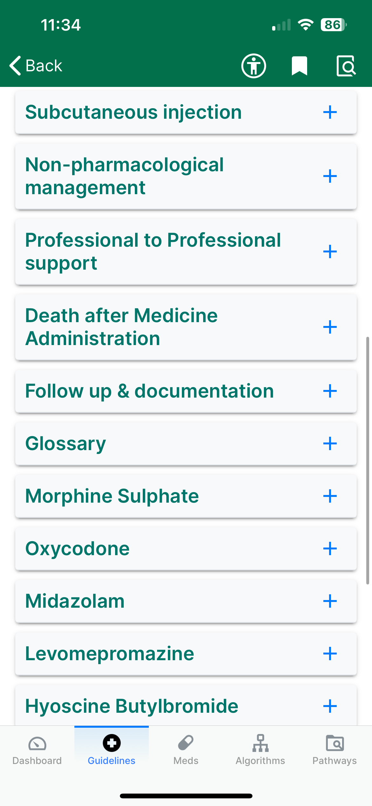
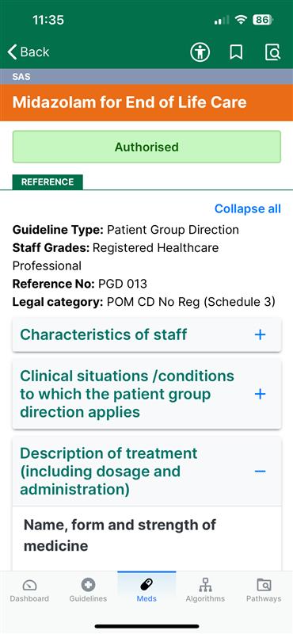
Scottish Ambulance Service
Development of new
Guidelines
sas.endoflifecare@nhs.scot
Notes:
"Crucially, we've also implemented new national guidelines. Our Technicians can now administer a patient's own prescribed JIC medications – a UK ambulance service first. And our Paramedics can now utilise SAS stock Midazolam for end-of-life symptom control, which is a vital tool.“
"The impact of all this is clear: our staff feel better equipped, more knowledgeable, and more assured in these often complex and emotionally demanding situations. And importantly, this enhanced capability enables more patients to receive the care they need, often allowing them to remain at home if that is their wish."

Slide 10
Scottish Ambulance Service
AS2 Transfer home to Hospice
Urgent Tier Crew Sent
Crew recognise symptoms
Case Study
Prof to Prof call with Hospice
JIC medication Administered
Appropriate care delivery
sas.endoflifecare@nhs.scot
Notes:
So what is the patient impact of these guidlelines?
I want to share a short case study about the real difference these changes are making.
SAS is well known for its emergency response, but what many do not reaslise we also offer an urgent response when another healthcare professional feels a patient needs admission they can request SAS convey the hospital.
This is what happened for Jack (name changed)
Jack was a 67 year old male with Stage 4 cancer and whilst his wife had been to care for him at home, things had become too much when she was unable to manage his pain. After speaking to the GP on the Phone admission to the local hospice was arranged.
Now as this was considered an urgent request rather than an emergency – one of our urgent tier vehicles was dispatched. This crew was made up of an ambulance technician and ambulance care assistant.
On arrival and after a short discussion the technician quickly identified that Jack appeared to be suffering from spinal cord compression (not previously mentioned) she phone the hospice and asked if they still wanted Jack to be brought to themselves or taken to the main hospital. The hospice discussed the findings with the technician and agreed hospital for Scan was the best option. They arranged this whilst the crew prepared Jack for moving. Not before they discussed with the technician the option of giving JIC meds, these were in the property and already prescribed so following a discussion of symptoms the decision to give morphine and midazolam before moving was agreed and the technican administered.
On arrival at the ward at hospital the staff were expecting the crew and Jack where they shortly afterwards took him for scan. Here it was confirmed that he was suffering from spinal cord compression.
The technician says ‘without completing the education session and reading the new guidelines I would not have been able to idenfity the care needs of this gentleman r provide him with the care he needed. Whilst this was a difficult job it was really rewarding to be able to ease his pain and get him the right care he needed.

Slide 11
Scottish Ambulance Service
Key Achievement: Improving Patient & Carer Experiences
Increase in Patients remaining in their own home 80% in 2024 and increase of 30% from 2019(pre project)
Increased feedback with 88% carers rating care by SAS clinicians as either excellent or good
  Increase in individuals experiencing care that is timely, clinically effective, respectful, and aligns with preferences.
sas.endoflifecare@nhs.scot
Notes:
"Beyond empowering our staff, this project is fundamentally about improving the experience of patients and their carers.“
"A key outcome, and one that often aligns with patients' wishes, is enabling them to remain at home if possible. following the administration of Just in Case medications by SAS crews, over 80% of patients were able to remain at home in 2024. This is a dramatic increase from approximately 30% in 2019.“
"The direct feedback we've received from carers, as part of the SAS Macmillan Project Carer Survey, underscores the positive impact:“
"An overwhelming 88% of carers rated the care provided by our ambulance crews as either 'Excellent' or 'Good'."
"And 87% reported that our clinicians 'always' or 'mostly' took the time to explain what was happening and what they were doing.“
"Carers also highlighted that our clinicians were able to provide medication for symptom relief, contact other health professionals when needed, and support decisions around conveyance to hospital or remaining at home.“
"The qualitative feedback, further illustrates this. We hear positive reflections from our own clinicians about the satisfaction of delivering appropriate, safe, and truly person-centred care. And we have received appreciation from partner organisations like hospices and community CNS teams, praising the collaborative working and the compassionate care provided by our crews."
"The overall impact is that more individuals in Scotland are experiencing care that is not only clinically effective but is also timely, respectful of their dignity, and aligned with their personal preferences and wishes."

Slide 12



Scottish Ambulance Service
Key Achievement: Optimising Care Pathways & Reducing Hospital Conveyance
Goal: More people to receive the right care in the right place at the right time
Reduction in conveyance - Only 32% of PEOLC patients conveyed to hospital in 2023
- 15,000 managed in their own home or preferred place of care
- Development of 29 pathways for alternative care other than emergency admission
Impact: Reduction in distressing ED visits, better alignment with preferred place of care, more efficient use of resources
sas.endoflifecare@nhs.scot
Notes:
"A central aim of this project has been to optimise care pathways, ensuring more people receive the right care, in the right place – which for many at the end of life, is their own home or a community setting – thereby avoiding unnecessary and often distressing hospital admissions.“
"We've made significant strides in reducing inappropriate hospital conveyance for this patient group. SAS Data analysis shows that in 2023, around 32% of palliative and end-of-life care patients attended by SAS were subsequently conveyed to hospital."
"To put that into perspective, this means approximately 15,000 palliative and end-of-life care patients were NOT conveyed to hospital but were managed within their own home or preferred place of care, thanks to the interventions and support our crews could provide."
"Furthermore, we managed 1,600 more palliative and end-of-life care patients on-scene (without conveyance) in 2023 compared to 2022."
"This has been enabled by the development of alternatives to hospital, we now have 29 new alternative pathways in place across Scotland. These provide our clinicians with options like direct admission to a hospice where appropriate, or access to professional-to-professional support lines for specialist advice."
"We're also actively working with partners to refine these.
"The impact here is multi-faceted: fewer distressing emergency department visits for patients, better alignment with their preferred place of care, and a more efficient use of our urgent care resources."

Slide 13
Scottish Ambulance Service
Challenges
Integrating new PEOLC pathways into complex urgent care systems.
Ensuring timely access to patient information (KIS/ACP, ReSPECT).
Shifting organisational culture to embed PEOLC as a core competency.
Securing long-term sustainability and resources.
sas.endoflifecare@nhs.scot
Notes:
"While the project has achieved significant success, it hasn't been without its challenges. However, we've adopted proactive approaches to address them.“
"A key challenge has been integrating new palliative and end-of-life care pathways into complex and often long-established urgent care systems. Our approach has been one of phased implementation, robust stakeholder engagement from the outset, establishing clear communication protocols, and ensuring continuous feedback loops to allow for adaptation.“
"Another challenge is ensuring our clinicians have timely and reliable access to crucial patient information, such as Key Information Summaries, Anticipatory Care Plans, or ReSPECT forms. Our approach here, as noted on page 20 of the Business Case, involves actively promoting the use and awareness of digital KIS, advocating for improved data sharing systems across health and social care, and linking closely with national developments in ECS and ReSPECT workstreams.“
"Shifting organisational culture to fully embed palliative and end-of-life care as a core competency within an emergency-focused service is an ongoing challenge. Our approach relies on sustained leadership commitment, continuous education and reinforcement of key messages, celebrating successes, and sharing positive patient and staff stories to build momentum.“
"And, of course, a persistent challenge is securing long-term sustainability and the necessary resources for these enhanced services. Our approach here is to clearly and robustly demonstrate the value this project delivers – through improved patient outcomes, enhanced staff wellbeing, and significant system efficiencies, as we've outlined in the business case and today."

Slide 14
Scottish Ambulance Service
Key Learnings from the Project
The Power of Education
Collaboration is Crucial
The Carer Perspective is Invaluable
Data Drives Improvement
Addressing Variation
Tailored Approaches
sas.endoflifecare@nhs.scot
Notes:
"Throughout this journey, we've gathered invaluable learnings that will shape our approach moving forward.“
"The Power of Education is undeniable. We've seen firsthand that dedicated, high-quality palliative and end-of-life care training demonstrably improves staff confidence, enhances their skills, and positively changes clinical practice."
"Collaboration is absolutely crucial. Effective pathway redesign and lasting system change simply cannot happen in isolation. They depend on strong, trusting partnerships across multiple agencies – health boards, HSCPs, hospices, primary care, and the third sector."
"The Carer Perspective is Invaluable. Truly person-centred services can only be designed by actively listening to and acting upon the experiences, needs, and insights of carers."
"Data Drives Improvement. Continuous monitoring, robust data collection, and thorough evaluation are vital. They allow us to understand our impact, identify areas where we can refine our approach, and critically, demonstrate the value of the work."
"Addressing Variation is essential, we've encountered significant variation across Scotland in areas like access to community nursing teams, out-of-hours medications, capacity within hospice and specialist palliative care services, access to GP services, and the availability of controlled drugs in care homes. Recognising and actively working to tackle these variations is key to ensuring equitable care."
"And finally, Tailored Approaches are necessary. Scotland is a diverse country, and we must recognise and address the unique challenges of delivering palliative and end-of-life care in all settings, particularly in our remote and rural communities."

Slide 15
Scottish Ambulance Service
The Journey Ahead: Sustainability & Future Vision
Sustaining the Model
Awaiting outcome of Business Case for sustainable funding
Expanding Focus & Key Priorities:
Frailty & Care Homes
Improving Access & Equity
Leveraging New Models
Expanding JIC Medication Use
Alternative Paramedic Models
Enhancing Clinical Pathways
Consider End of Life Care Coordinator Network
Goal:
Deliver more equitable, effective, patient-centred care, ensuring a sustainable response.
sas.endoflifecare@nhs.scot
Notes:
"So, what does the journey ahead look like? Our vision is to build on this success and ensure its long-term sustainability.
"Sustaining the Model is our clear preference and we are awaiting feedback for business case and funding options from SG sponsor team.
"With this sustained model, we aim to Expand our Focus and address Key Priorities,
"We will more formally integrate Frailty and Care Homes into our workstreams, recognising the significant needs in these areas."
"We will concentrate on Improving Access and Equity, with a particular focus on remote and rural areas, such as NHS Dumfries & Galloway where alternatives to ED conveyance are currently limited."
"We will Leverage New Models of Care, for example, working with NHS Argyll & Clyde's Hospital at Home model to improve care delivery for palliative patients and those in care homes."
"We plan to Expand the Use of Just in Case Medications by strengthening regional education to overcome barriers and reduce missed opportunities, especially in remote and rural settings."
"We want to explore Alternative Paramedic Models, such as rotational community support roles. The Welsh Ambulance Service has a successful model here which could provide valuable inspiration.
"We will continue Enhancing Clinical Pathways by working closely with our Integrated Clinical Hub to expand professional-to-professional referral pathways upstream, potentially reducing unnecessary ambulance dispatches."
"And we'll consider establishing an End of Life Care Coordinator Network, similar to the successful initiative in the London Ambulance Service, to create local champions and build regional capacity.“
"Our overall Goal is to deliver more equitable, more effective, and truly patient-centred care, ensuring a sustainable and responsive ambulance service for all of Scotland's communities as their healthcare needs evolve."

Slide 16
Scottish Ambulance Service
The SAS Macmillan PEOLC Project is making a tangible, positive difference, recognised by the 2024 Scottish Health Awards 'Top Team Award'.
It has empowered clinicians, improved patient/carer experiences, and created significant system efficiencies.
Represents a crucial advancement in Scotland's urgent PEOLC, aligning with national priorities.
Fundamentally about upholding dignity, respecting choice, and providing the best possible experience.
The SAS Board approved submission of the business case to the Scottish Government for ongoing funding in January 2025.
Conclusion:
A System Transformed at its Heart
sas.endoflifecare@nhs.scot
Notes:
"In conclusion, the Scottish Ambulance Service Macmillan Palliative and End of Life Care Project is demonstrably making a tangible, positive difference to the lives of some of the most vulnerable people in Scotland, and their families. The recent 'Top Team Award' at the 2024 Scottish Health Awards is a wonderful external validation of this.“
"This initiative has empowered our dedicated SAS clinicians, equipping them to deliver care with enhanced skill, greater compassion, and increased confidence.“
"It represents a crucial advancement in how Scotland provides urgent care for those approaching the end of life, an advancement that aligns directly with national strategic priorities.“
"Fundamentally, this project is about upholding dignity, respecting patient choice, and striving to provide the best possible experience during one of life's most profound and challenging journeys.“
"It's important to note that the Scottish Ambulance Service Board reviewed and approved the submission of the business case for this continued work to the Scottish Government for ongoing funding in January 2025

Slide 17
Scottish Ambulance Service
Considerations for the Cross-Party Group
Recognition: Acknowledge the significant achievements, patient impact, and system-wide economic benefits of this collaborative project.
Support for Sustainability: Champion the SAS Palliative care team to sustain and expand this vital service, including its broadened focus on frailty and care homes.
Policy Enablement: Continue to support policies that enhance seamless information sharing and integrated working for PEOLC.
Advocacy: Continue to recognise the critical and evolving role of SAS in delivering high-quality, compassionate PEOLC.
sas.endoflifecare@nhs.scot
Notes:
"As members of the Cross-Party Group for Palliative Care, your understanding and support are invaluable. We would ask you to consider the following:“
"Firstly, Recognition: We ask that you acknowledge the significant achievements of this collaborative project, the profound positive impact it's having on individuals and families.“
"Secondly, Support for Sustainability: We urge you to champion the SAS palliative care team, which is essential to sustain and expand this vital service. This will allow us to maintain the experienced team and broaden our focus to critical areas like frailty and care homes.“
"Thirdly, Policy Enablement: Your continued support for policies and initiatives that further enhance seamless information sharing – such as universal digital Anticipatory Care Plans and Key Information Summaries – and that promote truly integrated working for palliative and end-of-life care, will be crucial.“
"And finally, Advocacy: We ask that you continue to recognise and advocate for the vital and evolving role of the Scottish Ambulance Service in delivering high-quality, compassionate palliative and end-of-life care within our communities across Scotland."

Slide 18
Scottish Ambulance Service
Thank You & Questions
Thank you for your time and attention
Open for questions
sas.endoflifecare@nhs.scot
Notes:
"That concludes our presentation. Thank you very much for your time and attention this evening. We are now happy to answer any questions you may have."

