Slide 1





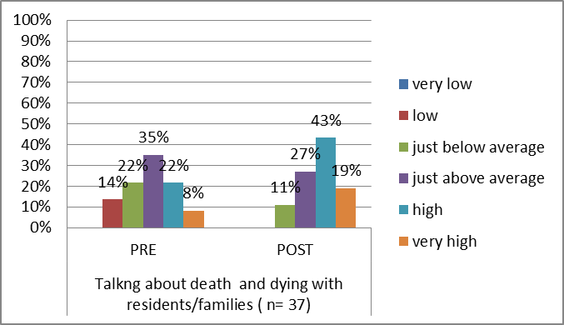
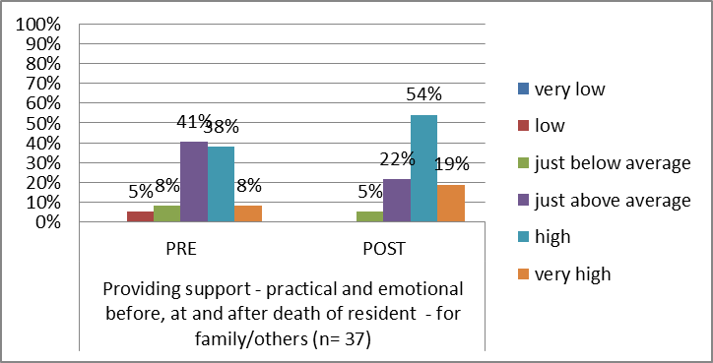
Implementing the adapted “6 steps”* approach
An end of life care project for local care homes
Project team : Margaret Ramsay, Project Palliative Care Facilitator (PCF); NHS Forth Valley; Jackie Higgins , Practice Educator, Strathcarron Hospice; Sandra Campbell, Macmillan Nurse Consultant for Cancer and Palliative Care , NHS Forth Valley; Dr Erna Haralsdottir, former Head of Education, Strathcarron Hospice
Background
Recognised need for further training in end of life care in response to reactive education and requests from care homes
Demographic changes and increasing need for end of life care in care homes which may lead to inappropriate admission of frail elderly residents to acute hospital
Secured bid for monies from Falkirk, Stirling & Clackmannanshire Change fund ‘ Reshaping Care for Older People’
Aims
To improve knowledge, skills and confidence in provision of end of life care
Increase implementation of tools and systems to promote a co-ordinated approach to end of life care
Promote effective advance/anticipatory care planning
Promote an individual person centred approach to EOL care
Enhance carer support and bereavement care
Project Outline
Liaised with care home managers and invited them to information days
Designed and delivered taught component of course over 6 months
Facilitated monthly action learning sets
PCF continued to visit care homes and support participants to develop individual projects
Additional education sessions delivered as requested
Reach
37 care homes invited
23 care homes engaged
15 private care homes
8 local authority
49 participants identified
30 registered nurses
19 social care workers
Examples of Participant Projects
Implemented some principles of Gold Standards Framework including setting up Palliative Care Register
Established Namaste sessions
Set up bereavement service
Utilised new NHS FV End of Life Care Plan to replace LCP
Introduced NHSFV ‘Thinking Ahead’ ACP booklet as appropriate
Increased utilisation of ‘Just in Case’ medication
Project Challenges
Change of management and personnel in some care homes
Obtaining post evaluation forms
Arranging suitable times for PCF to visit care homes
A single participant trying to manage change within their own organisation
Finding time to cascade learning to colleagues
Despite the above challenges, the outcomes were achieved
Examples of Project Evaluation
The graph below demonstrates an overall
positive trend in confidence ratings post taught
component for those (both Registered nurses
and social care workers) who responded to the
following domains; ‘Talking about death and dying’
The graph below demonstrates an overall
positive trend in confidence ratings post taught
component for those (both Registered nurses
and social care workers) who responded to the
following domains; ‘Talking about death and dying’
This positive trend in confidence was also demonstrated in other essential domains related to quality end of life care, e.g. providing practical and emotional support before, at and after death
Excellent and informative content allowing interaction and discussion. Teaching staff very helpful and approachable and willing to help with roll out project and wider changes
The training when we discussed death ……..After a lot of reflection I think I have become more self aware enabling me to become a better communicator
Participants’
Comments
Has helped by informing of systems that I was not aware of and should have in place
This course has been invaluable to me as a newly qualified nurse. It has provided a deeper understanding of EOL and has given me so much to deliver high quality EOL care
It was so good. It is great we have support to carry on work we are going to put into practice. It has really enhanced my understanding of EOL care

